Slide 1
Trees 3: The Binary Search Tree
Reading: Sections 4.3 and 4.6

Slide 2
Binary Search Tree
Also known as Totally Ordered Tree
Definition: A binary tree B is called a binary search tree iff:
There is an order relation < defined for the vertices of B
For any vertex v, and any descendant u of v.left, u < v
For any vertex v, and any descendent w of v.right, v < w
Let us also assume that all keys are different
root
4
2
6
1
3
5
7

Slide 3
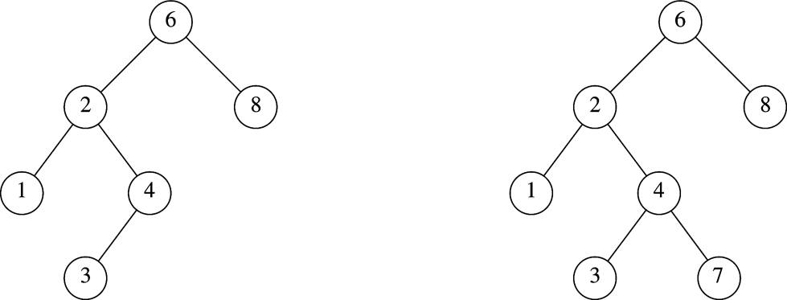
Binary Search Tree
Which one is NOT a BST?

Slide 4
Binary Search Tree
Consequences:
The smallest element in a binary search tree (BST) is the “left-most” node
The largest element in a BST is the “right-most” node
Inorder traversal of a BST encounters nodes in increasing order
root
4
2
6
1
3
5
7

Slide 5
Binary Search using BST
Assumes nodes are organized in a totally ordered binary tree
Begin at root node
Descend using comparison to make left/right decision
if (search_value < node_value) go to the left child
else if (search_value > node_value) go to the right child
else return true (success)
Until descending move is impossible
Return false (failure)
root
4
2
6
1
3
5
7

Slide 6
Search in BST
Exercise: show all nodes visited when trying to find 55 in the following BST
Exercise: show all nodes visited when trying to find 105
root
100
50
200
10
70
110
230
60
120
55

Slide 7
Binary Search using BST
Runtime <= descending path length <= depth of tree or height of the tree
If tree height is O(lg(N)), runtime <= O(log size)

Slide 8
Insert in BST
Where to insert 130?
Not all spots are equal! Need to maintain the total order of BST
130?
root
100
50
200
10
70
110
230
60
120
130?
55

Slide 9
Insert in BST
Where should 130 be inserted?
Insert in the middle of the tree (1) sometimes requires tree restructuring, and (2) cannot be decided without doing a full failed search
Insert as a leaf
root
100
130?
50
200
130?
10
70
110
230
130?
60
120
55
130?

Slide 10
Insert in BST
Where should 130 be inserted?
Insert in the middle of the tree requires
Insert as a leaf
root
100
130?
50
200
130?
10
70
110
230
130?
60
120
55
130?

Slide 11
Insert in BST
Where to insert as a leaf?
Do a search, the place where the search fails is the place where the new node should be inserted!
root
100
50
200
10
70
110
230
60
120
55
130

Slide 12
Insert in BST
Exercise: Where to insert 57 and 210?
root
100
50
200
10
70
110
230
60
120
55

Slide 13
Delete in BST
Delete 70 or 110 how to fix the tree?
70 and 110 only have one child
Link its child to the parent will keep the total order property!
root
100
50
200
10
70
110
230
60
120
55

Slide 14
Delete in BST
Delete 70 or 110 how to fix the tree?
70 and 110 only have one child
Link its child to the parent will keep the total order property!
root
100
50
200
10
70
110
230
60
120
55

Slide 15
Delete in BST
Delete 100, how to fix the tree? Need to find a new root!
10, 50, 55, 60, 70, 100, 110, 120, 200, 230
root
100
50
200
10
70
110
230
60
120
55

Slide 16
Delete in BST
Delete 100.
10, 50, 44, 60, 70, 110, 120, 200, 230
Candidates are 70 and 110. How to describe their position in the tree?
root
100
50
200
10
70
110
230
60
120
55

Slide 17
Delete in BST
Delete 100
Pick 70 (largest node in the left tree) to be new root
Assign 70’s left child to be the right child of 70’s parent
What about 70’s right child?
root
100
50
200
10
70
110
230
60
120
55

Slide 18
Delete in BST
Delete 100
If pick 70 (largest node in the left tree) to be new root
Assign 70’s left child to be the right child of 70’s parent
What about 70’s right child?
root
70
50
200
10
60
110
230
55
120

Slide 19
Delete in BST
Delete 100
If pick 110 (smallest node in the right tree) to be new root
Assign 110’s right child to be the left child of 110’s parent
What about 110’s left child?
root
110
50
200
10
60
120
230
55

Slide 20
Delete in BST
Exercise
How is the tree look like after delete 50?
root
110
50
200
10
60
120
230
55

Slide 21
BST Class Template
Template <typename Comparable>
Class BinarySearchTree {
public:
BinarySearchTree();
BinarySearchTree(const BinarySearchTree & rhs); // copy
BinarySearchTree(BinarySearchTree &&rhs); // move
~BinarySearchTree();
const Comparable & findMin() const;
const Comparable & findMax() const;
bool contains(const Comparable &x) const;
bool isEmpty() const;
void printTree(ostream & out = std::cout) const;
void makeEmpty();
void insert(const Comparable &x);
void insert(Comparable &&x); // move
void remove(const Comparable &x);
BinarySearchTree & operator=(const BinarySearchTree &rhs);
BinarySearchTree & operator=(BinarySearchTree && rhs); // move

Slide 22
BST Class Template (Cont’d)
private:
struct BinaryNode {
Comparable element;
BinaryNode *left;
BinaryNode *right;
BinaryNode(const Comparable &theElement, BinaryNode *lt, BinaryNode *rt)
: element{theElement}, left{lt}, right{rt} {}
BinaryNode(Comparable && theElement, BinaryNode *lt, BinaryNode *rt)
: element{std::move(theElement)}, left{lt}, right{rt} {}
};
BinaryNode *root;
void insert(const Comparable &x, BinaryNode * & t);
void insert(Comparable &&x, BinaryNode * &t);
void remove(const Comparable &x, BinaryNode * & t);
BinaryNode *findMin(BinaryNode *t) const;
BinaryNode *findMax(BinaryNode *t) const;
bool contains(const Comparable &x, BinaryNode *t) const;
void makeEmpty(BinaryNode * &t);
void printTree(BinaryNode *t, ostream & out) const;
BinaryNode *clone(BinaryNode *t) const;
};
Pointer passed by reference
(why?)
Internal functions
used in recursive
calls

Slide 23
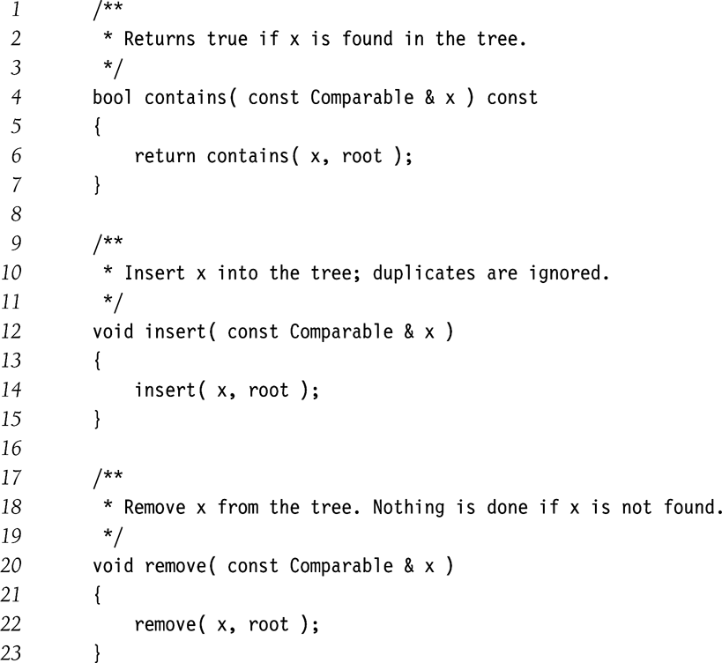
BST: Public members calling private recursive functions

Slide 24
BST: Searching for an element
/**
* Internal method to test if an item is in a subtree.
* x is item to search for.
* t is the node that roots the subtree.
*/
bool contains( const Comparable & x, BinaryNode *t ) const
{
if( t == nullptr )
return false;
else if( x < t->element )
return contains( x, t->left );
else if( t->element < x )
return contains( x, t->right );
else
return true; // Match
}

Slide 25
BST: Find the smallest element
/**
* Internal method to find the smallest item in a subtree t.
* Return node containing the smallest item.
*/
BinaryNode * findMin( BinaryNode *t ) const
{
if( t == nullptr )
return nullptr;
if( t->left == nullptr )
return t;
return findMin( t->left );
}
Tail recursion

Slide 26
BST: Find the biggest element
/**
* Internal method to find the largest item in a subtree t.
* Return node containing the largest item.
*/
BinaryNode * findMax( BinaryNode *t ) const
{
if( t != nullptr )
while( t->right != nullptr )
t = t->right;
return t;
}
Non-recursive

Slide 27
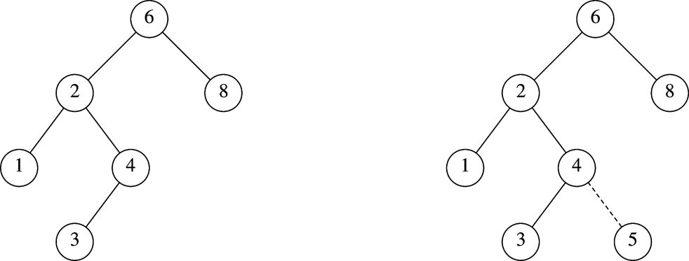
BST: Insertion (5)
Before insertion
After insertion

Slide 28
BST: Insertion (contd.)
/**
* Internal method to insert into a subtree.
* x is the item to insert.
* t is the node that roots the subtree.
* Set the new root of the subtree.
*/
void insert( const Comparable & x, BinaryNode * & t )
{
if( t == nullptr )
t = new BinaryNode{ x, nullptr, nullptr };
else if( x < t->element )
insert( x, t->left );
else if( t->element < x )
insert( x, t->right );
else
; // Duplicate; do nothing
}
How to implement the move version of insert()?
Strategy:
Traverse the tree as if searching for x with contains()
Insert when you reach a null pointer t.

Slide 29
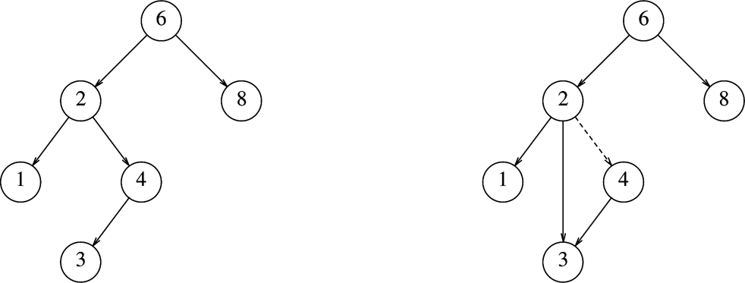
BST: Deletion
Deleting a node with one child
Before deleting (4)
After deleting (4)
Deletion Strategy: Bypass the node being deleted

Slide 30
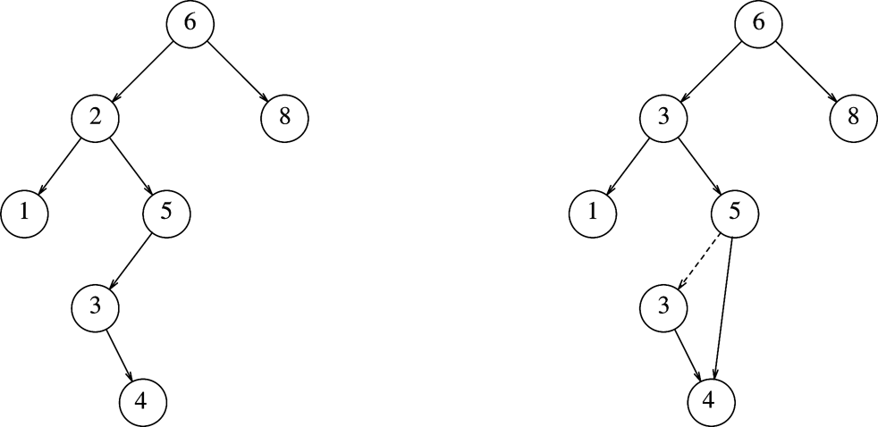
BST: Deletion (contd.)
Deleting a node with two children
Before deleting (2)
After deleting (2)
Deletion Strategy: Replace the node with
smallest node in the right subtree

Slide 31
BST: Deletion (contd.)
/**
* Internal method to remove from a subtree.
* x is the item to remove.
* t is the node that roots the subtree.
*/
void remove( const Comparable & x, BinaryNode * & t ) {
if( t == nullptr )
return; // Item not found; do nothing
if( x < t->element )
remove( x, t->left );
else if( t->element < x )
remove( x, t->right );
else if( t->left != nullptr && t->right != nullptr ) { // two children
t->element = findMin( t->right )->element;
remove( t->element, t->right );
}
else {
BinaryNode *oldNode = t;
t = ( t->left != nullptr ) ? t->left : t->right;
delete oldNode;
}
}

Slide 32
BST: Lazy Deletion
Another deletion strategy
Don’t delete!
Just mark the node as deleted.
Wastes space
But useful if deletions are rare or space is not a concern.

Slide 33
BST: Destructor
/**
* Destructor for the tree
*/
~BinarySearchTree( )
{
makeEmpty( );
}
/**
* Internal method to make subtree empty.
*/
void makeEmpty( BinaryNode * & t )
{
if( t != nullptr )
{
makeEmpty( t->left );
makeEmpty( t->right );
delete t;
}
t = nullptr;
}

Slide 34
BST: Assignment Operator
/**
* Copy constructor
*/
BinarySearchTree( const BinarySearchTree & rhs ) : root{ nullptr }
{
root = clone( rhs.root );
}
/**
* Internal method to clone subtree.
*/
BinaryNode * clone( BinaryNode *t ) const
{
if( t == nullptr )
return nullptr;
else
return new BinaryNode{ t->element, clone( t->left ), clone( t->right ) };
}

Slide 35
Tree Traversal (Inorder)
// Print the tree contents in sorted order.
void printTree( ostrem & out ) const
{
if( isEmpty( ) )
cout << "Empty tree" << endl;
else
printTree( root, out);
}
/**
* Internal method to print a subtree rooted at t in sorted order.
*/
void printTree( BinaryNode *t, ostream & out ) const
{
if( t != nullptr )
{
printTree( t->left );
out << t->element << endl;
printTree( t->right );
}
}

Slide 36
BST: Search using function objects
Template <typename Object, typename Comparable=less<Object>>
class BinarySearchTree {
public:
// same methods, with Object replacing Comparable
private:
BinaryNode *root;
Comparable isLessThan;
// same methods, with Object replacing Comparable
bool contains( const Comparable & x, BinaryNode *t ) const
{
if( t == nullptr )
return false;
else if( isLessThan(x, t->element ))
return contains( x, t->left );
else if( isLessThan(t->element ,x ))
return contains( x, t->right );
else
return true; // Match
}
};

Slide 37
BST: Insertion Bias
Start with an empty tree.
Insert elements in sorted order
What tree do you get?
How do you fix it?

Slide 38
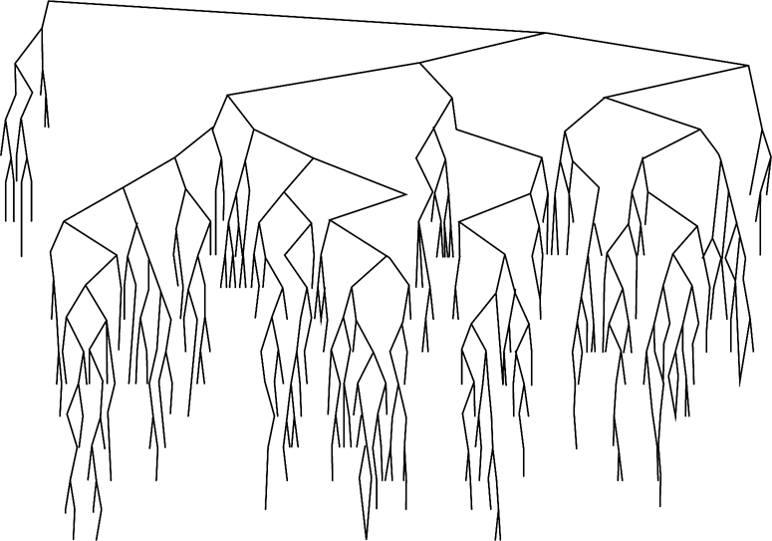
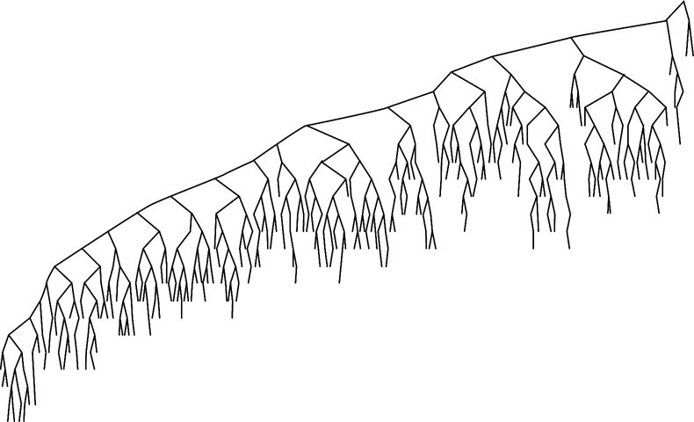
BST: Deletion Bias
After large number of alternating insertions and deletions
Why this bias? How do you fix it?

Slide 39
Reading assignment
Sections 4.4, 4.7, and 4.8

