Slide 1
Lecture 10 Introduction to Database

Slide 2
Acknowledgement
The materials on databases are adapted from slides by Professor Peixiang Zhao for COP4710, as well as slides from earlier offering of COP4521 by Sharanya Jayaraman and Karen Works.

Slide 3
Database
A database is a collection of data stored electronically, usually organized and structured in some form.
Databases can be very simple – a text file or a CSV file, for example.
When they are complex, we use formal methods of design and engineering principles, to build, update and maintain these systems.
A DataBase Management System (DBMS) is the software used to interact between the database and an application that uses the database.
Data in databases is usually stored as tables (Relational) or through some form of XML or JSON-based collections (NOSQL).

Slide 4
Database Management System (DBMS)
System for providing EFFICIENT, CONVENIENT, and SAFE MULTI-USER storage of and access to MASSIVE amounts of PERSISTENT data
  Lots of demand for such systems.

Slide 5
Banking System – A Motivating Example for Database
Data
  Information on accounts, customers, balances, current interest rates, transaction histories, etc.
Massive
  Many gigabytes at a minimum for large banks, more if keep history of all transactions, even more if keep images of checks -> Far too big for memory
Persistant
  Data outlives programs that operate on it

Slide 6
Banking System – A Database Example
Safe
  from system failures
  from malicious users
Convenient
  simple commands to - debit account, get balance, write statement, transfer funds, etc.
  also unpredicted queries should be easy
Efficient
  don't search all files to get the balance of one account, get all accounts with low balances, get large transactions, etc.
  massive data! -> DBMS's carefully tuned for performance

Slide 7
Banking System – A Database Example
Multi-user access: many people/programs accessing same database, or even same data, simultaneously. There are concurrency issues and needs careful control.
  Alex @ ATM1 (New York): withdraw $100 from account #007
    get balance from database;
  if balance >= 100 then balance := balance - 100;
  dispense cash;
  put new balance into database;
  Bob @ ATM2 (Tallahassee): withdraw $50 from account #007
  get balance from database;
  if balance >= 50 then balance := balance - 50;
  dispense cash;
  put new balance into database;
  Initial balance = 200. Final balance = ??

Slide 8
Banking System – A Database Example
Can we do it on a regular file system?
  Storing data: file system is limited
    size limit by disk or address space
    when the system crashes, we may lose data
    password/file-based authorization insufficient
  Query/update:
    need to write a new C++/Java program for every new query
    need to worry about performance
  Concurrency: limited protection
    need to worry about interfering with other users
    need to offer different views to different users (e.g. registrar, students, professors)
  Schema change:
    entails changing file formats
    need to rewrite virtually all applications
This is what motivates DBMS!

Slide 9
DBMS Architecture
User/Web Forms/Applications/DBA
query
transaction
DDL commands
Query Parser
Transaction Manager
DDL Processor
Query Rewriter
Query Optimizer
Concurrency Control
Logging &
Recovery
Query Executor
Records
Indexes
Lock Tables
Buffer:
data, indexes, log, etc
Buffer Manager
Main Memory
Storage Manager
Storage
data, metadata, indexes, log, etc
CS411

Slide 10
Data Structuring: Model, Schema, Data
Data model
  Conceptual structuring of data stored in database
    Higher level than schema and decides what can be in the schema
  ex: data is set of records, each with student-ID, name, address, courses, photo
  ex: data is graph where nodes represent cities, edges represent airline routes
Schema versus data
  Schema: is the blueprint of the database, specifying data fields and their types (how data is to be structured in the database).
    defined at set-up time, rarely changes (also called "metadata")
  Data is actual "instance" of database, changes rapidly
    Data is stored in the databased at a particular time
  vs. types and variables in programming languages

Slide 11
Schema vs. Data
Schema: name, name of each field, the type of each field
  Students (Sid:string, Name:string, Age: integer, GPA: real)
  A template for describing a student
Data: an example instance of the relation
Sid | Name | Age | GPA
0001 | Alex | 19 | 3.55
0002 | Bob | 22 | 3.10
0003 | Chris | 20 | 3.80
0004 | David | 20 | 3.95
0005 | Eugene | 21 | 3.30

Slide 12
DDL and DML
Data definition language (DDL)
  commands for setting up schema of database
Data Manipulation Language (DML)
  Commands to manipulate data in database:
    RETRIEVE, INSERT, DELETE, MODIFY
  Also called "query language"

Slide 13
Key Steps in building a (relational) DB application
Step 1: Conceptual design
  Use a modeling language to express what to model in the application
    ER model or relational model are popular models
  With the ER model, the output of this step is an ER diagram of the application domain
Step 2: Select a type of DBMS
  Relational DBMS is currently the most popular DBMS
Step 3: Translate a model design to a relational schema (assume that a relational DBMS is selected)
  Use a set of rules to translate from ER to relational schema
  Use a set of schema refinement rules to transform the above relational schema into a good relational schema

Slide 14
Key Steps in building a DB application
Step 4: Implement the relational DBMS using a "database programming language" called SQL
Step 5: Write the application program (in C++, Python, Java, PHP) to handle user interactions and take care of things that the database does not do.
  Ordinary users do not know SQL, and cannot directly interact with the database.

Slide 15
ER Model
A language to specify
  What information a database must hold
  What are the relationships among components of that information
Proposed by Peter Chen in 1976
  "The Entity-Relationship Model --- Toward a Unified View of Data". in ACM transactions on database systems (TODS)

Slide 16
Components of ER model
ER model consists of entities, attributes, and relationships among entities
Entities
  Real-world objects distinguishable from other objects. Example: a company, a product, a job, a course, etc.
  Described by a set of attributes
Attributes
  each has an atomic domain: string, integers, reals, etc.
price
name
category
name
stock price
Product
Company

Slide 17
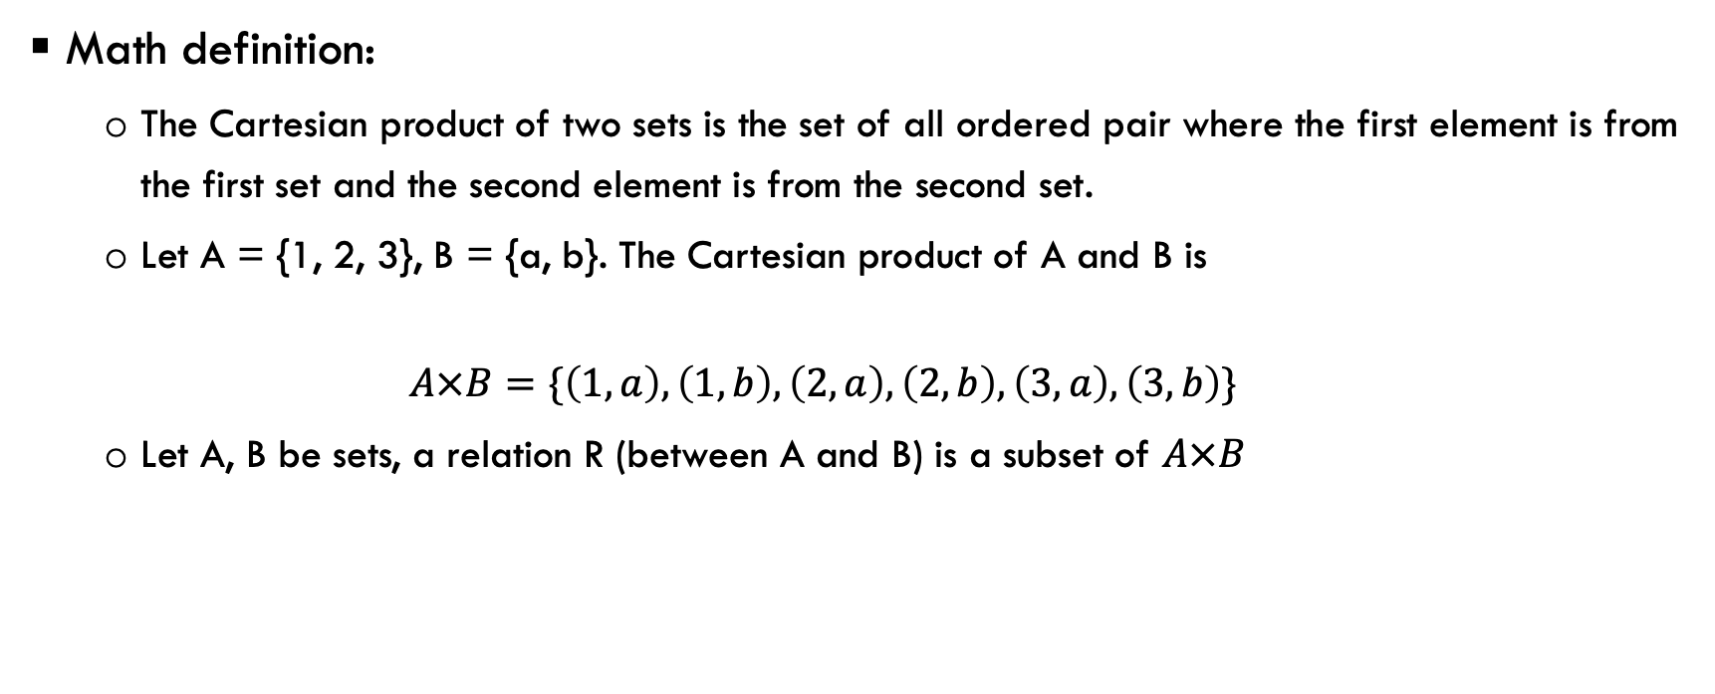
(Binary) Relationship
Math definition:
  The Cartesian product of two sets is the set of all ordered pair where the first element is from the first set and the second element is from the second set.
  Let A = {1, 2, 3}, B = {a, b}. The Cartesian product of A and B is
  $$A×B=\{\left(1, a\right), \left(1, b\right), \left(2, a\right), \left(2, b\right), \left(3, a\right), \left(3, b\right)\}$$
  Let A, B be sets, a relation R (between A and B) is a subset of $A×B$

Slide 18
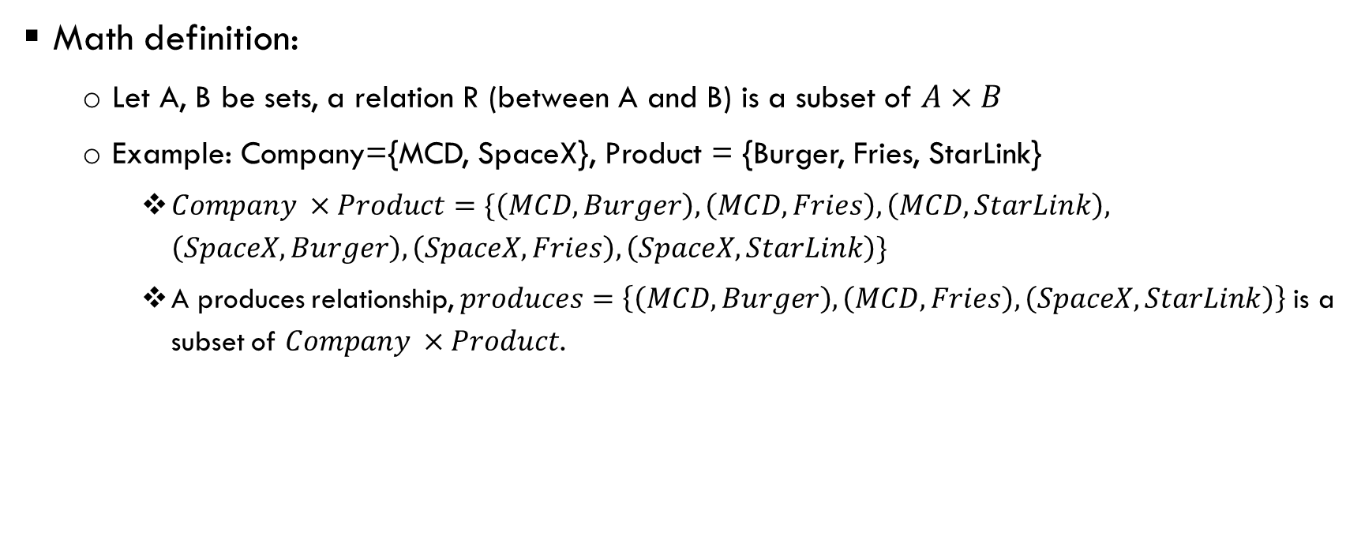
(Binary) Relationship
Math definition:
  Let A, B be sets, a relation R (between A and B) is a subset of $A×B$
  Example: Company={MCD, SpaceX}, Product = {Burger, Fries, StarLink}
    $Company ×Product=\{\left(MCD, Burger\right), \left(MCD, Fries\right), \left(MCD, StarLink\right), \left(SpaceX, Burger\right), \left(SpaceX, Fries\right), \left(SpaceX, StarLink\right)\}$
    A produces relationship, $produces=\left\{\left(MCD, Burger\right), \left(MCD, Fries\right), \left(SpaceX, StarLink\right)\right\}$ is a subset of $Company ×Product$.
MCD
Burger
Fries
Company
produces
Product
SpaceX
StarLink
Company
Product

Slide 19
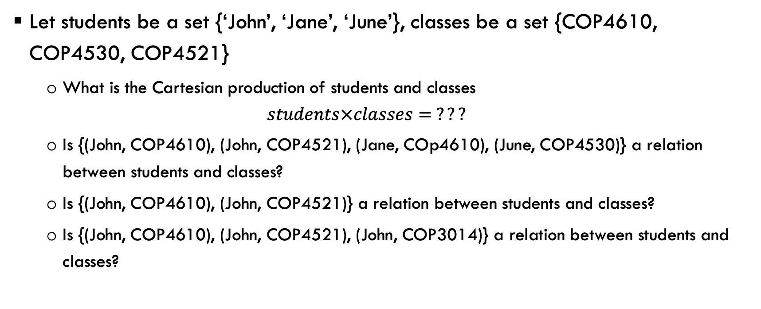
Exercise
Let students be a set {‘John’, ‘Jane’, ‘June’}, classes be a set {COP4610, COP4530, COP4521}
  What is the Cartesian production of students and classes
  $$students×classes= ???$$
  Is {(John, COP4610), (John, COP4521), (Jane, COp4610), (June, COP4530)} a relation between students and classes?
  Is {(John, COP4610), (John, COP4521)} a relation between students and classes?
  Is {(John, COP4610), (John, COP4521), (John, COP3014)} a relation between students and classes?

Slide 20
Multiplicity of E/R Relationship
one-one:
many-one
many-many
1
2
3
a
b
c
1
2
3
a
b
c
d
1
2
3
a
b
c
d

Slide 21
Multiway relationship
date
Product
Purchase
Store
Person

Slide 22
Convert multiway relationship to Binary
ProductOf
Product
Purchase
StoreOf
Store
date
BuyerOf
Person

Slide 23
Relationships: summary
Modeled as a mathematical set
Binary and multiway relationships
Converting a multiway one into many binary ones
Constraints on the degree of the relationship
  many-one, one-one, many-many
Attributes of relationships

Slide 24
An ER-Model Example
An employee can work in many departments, and a department can have many employees.
Each department has at most one manager.
name
dname
ssn
lot
did
budget
Employees
Manages
Departments
Works_In

Slide 25
Relational Model
E. F. Codd’s Relational Database Model is a mathematical structure in which data resides
  Codd, Edgar Frank (June 1970). "A Relational Model of Data for Large Shared Data Banks" (PDF). Communications of the ACM. 13 (6): 377–87.
Conceptual model based on Codd’s mathematical data model

Slide 26
Relational Model
Both ER model and relational model are used to model data
ER model
  Models the data using entities, relationships, and attributes
  Well-suited for capturing the application requirements
  Not well-suited for computer implementation
Relational model
  Model the data with one single concept: relation
  The world is represented with a collection of relations (tables)
  Well-suited for efficient implementation on computer

Slide 27
Relations (Tables)
Schema of a relation: R(A₁, A₂, …, A_{k})
  Relation name
  Attribute names
  Attribute types (domains)
Schema of a database: R₁(…), R₂(…),…, R_{n}(…)
  A set of relation schemas

Slide 28
An Example Relation
Name of Table (Relation)
Column (Field, Attribute)
Products
Name | Price | Category | Manufacturer
Gizmo | 19.99 | Gadgets | Gizmo works
Power gizmo | 29.99 | Gadgets | Gizmo works
Single touch | 149.99 | Photography | Canon
Multi touch | 203.99 | househould | Hitachi
Row (Record, Tuple)
Domain (Atomic type)

Slide 29
Relational Schema
Formal description of a table
Blueprint containing all the information needed to create the table
  Relation name
  Attribute names
  Attribute types (domains)
Employee(EmployeeNum:INTEGER,
LName:STRING,
FName:STRING,
DeptNum:INTEGER,
Age:INTEGER)
1) Primary key (EmployeeNum) Attribute Name is underlined.
2) Attribute Name: Domain Name Pair (Age:INTEGER)
3) Domain Name is the data type of the attributes

Slide 30
Attribute Domain
A Domain is the set of values an attribute may take.
An attribute’s domain:
  data type of the attribute
  optionally a user-defined set of values.
Example: the domain of Age:
  data type: integer
  user-defined set of values: between 0 and 120 inclusive
    The only values that may exist in the attribute Age of any tuple in the Employee relation can only be between 1 and 120.

Slide 31
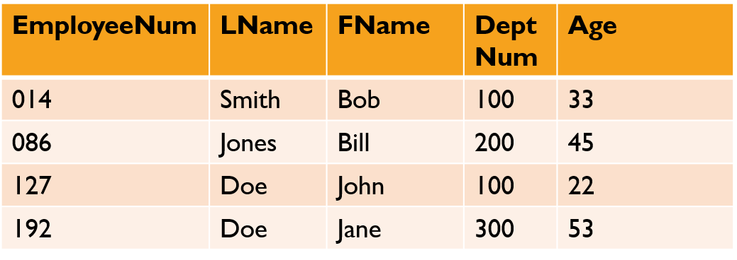
Rules for Relations (Tables)
No two rows can have the exact same contents as each other: rows are unique.
All the rows of a particular column draw their values from the same attribute domain.
Attribute values are atomic.
  An attribute cannot contain a list, array, object, or any compound data structure.
Employee
relation

Slide 32
Rules for Relations (Tables)
4. There can be rules called integrity constraints declared on the tables which the tables automatically obey. For example, each row of a child table might be required to have a corresponding row in a parent table.
5. The order of the rows makes no difference.
6. The order of the columns makes no difference.
Employee
relation

Slide 33
Relations (Tables) and classes (in OOP)
Tables are like OO classes.
Each row is like an instance of the class.
Each column represents a characteristic or instance variable.
Employee
relation

Slide 34
Key Attributes
The key attribute is an attribute (or a combination of attributes) whose:
  values are unique for each row in the table and,
  in the context of the object, makes sense to use as an identifier.
Primary Key is the main identifier for rows in a table.
Each table has one primary key.

Slide 35
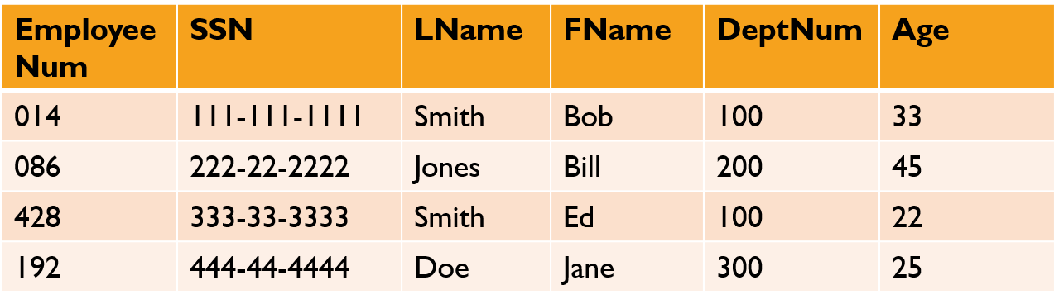
Candidate Keys
When there are multiple attributes that each could serve as a primary key, we call them Candidate Keys.
Each one may be chosen as the Primary Key.
Employee
relation

Slide 36
Foreign Key
A Foreign Key is a field whose values are keys in another relation
  Must correspond to primary key of the second relation
  Like a `logical pointer’
Foreign key links the two tables via common values between the PK and the FK
This is the mechanism we use to link tables together in the Relational Model

Slide 37
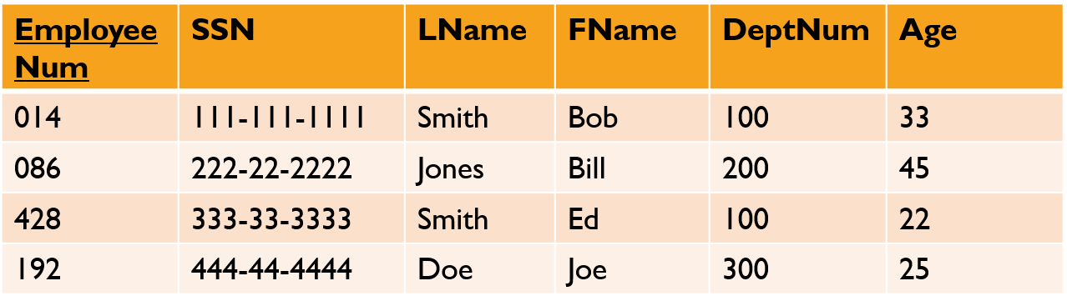
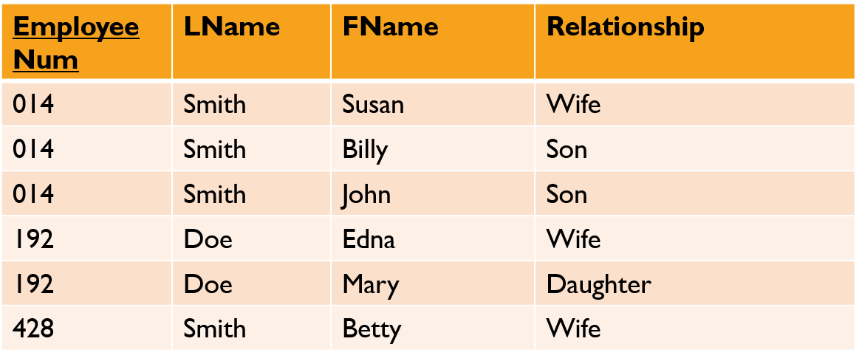
Foreign Key
PK
Employee
FK
FamilyMember

Slide 38
Translate ER Diagram into Relations
Translate entity
ER diagram
Relation Schema
E
E = ( a₁, …, a_{n} )
a₁ ….. a_{n}

Slide 39
Translate ER Diagram into Relations
Translate relation
ER diagram
Relation Schema
E1
R1
E2
R1= ( a₁, b₁, c₁, …, c_{k} )
a₁ …. a_{n}
c₁ …. c_{k}
b₁ …. b_{m}

Slide 40
Example
name
ssn
lot
Employees

Slide 41
Example
name
dname
ssn
lot
did
budget
Employees
Manages
Departments
Works_In
Four tables:
  Employees(ssn, name, lot)
  Departments(did, dname, budget)
  Manages(ssn, did)
  Works_in(ssn, did)

Slide 42
Structured Query Language (SQL)
SQL is the language used to create, query and change
  The relation schema (the structure of the tables)
  The data in the tables
Once we have the relational model for an application, we can implement the model using SQL.

