Slide 1
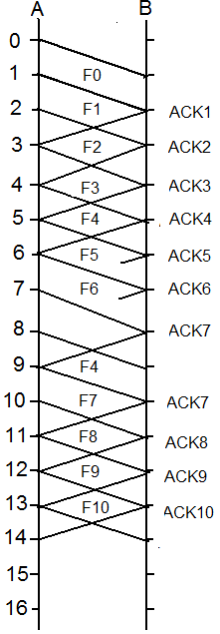
Lecture 7 review
Consider a link running the Go-Back-N protocol. Suppose the transmission delay and propagation delay are both 1ms, the window size is 3, and the timeout is 3ms (start to count after the last bit of a frame is sent). Suppose the sender starts to send at time 0 and no data frame is ever lost, and all ACKs are received except the ACKs the receiver sends at time 6ms and 7 ms. Please finish the following figure for both the sender and receiver side till 14ms.
What about the name go-back-N?

Slide 2
Error correction and detection
What is the general approach?
Define hamming distance.
What is the relationship between Hamming distance and error correction and detection capability?
Error control: when to use error correction code and when to use error detection and recovery?
CRC code, how does it work?

