Slide 1
CUDA programming II - thread organization

Slide 2
CUDA thread organization
Each time the host code launches a kernel, it generates a 3-dimensional grid of blocks with each block being a 3-dimensional block of threads
dim3 dimGrid(32, 1, 1)
dim3 dimBlock(128, 1, 1)
vecAdd<<<dimGrid, dimBlock>>> (-);
Programmer can reduce 3D to 2D or 1D by setting size of the unused dimension to be 1.
In the above example, the grid and block are actually 1D.
CUDA C provides a short-cut for specifying 1D grids and blocks with a number for the x dimension and assuming y and z dimensions are 1.
vecAdd<<<32, 128>>> (-);

Slide 3
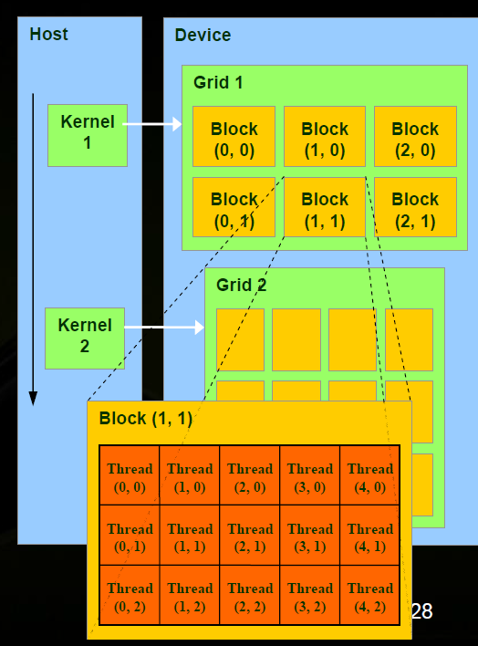
CUDA thread organization
Each thread can access its block ID and thread ID.
This is used to decide which data to work on
blockIdx of dim3 type for block ID
blockIdx.x, blockIdx.y, blockIdx.z
threadIdx of dim3 type for thread ID
The thread (2,0) in block (1,1) will have:
blockIdx.x ==1, blockIdx.y==1, blockIdx.z==0
threadIdx.x ==2, threadIdx.y =0 0, threadIdx.z ==0

Slide 4
Compute global 1-D thread ID
threadIdx, blockIdx and blockDim are of the dim3 type
threadIdx.x -- “thread index” within block in “x” dimension
blockIdx.x -- “block index” within grid in “x” dimension
blockDim.x -- “block dimension” in “x” dimension (i.e. number of threads in a block in the x dimension
Full global thread ID in x dimension can be computed by:
x = blockIdx.x * blockDim.x + threadIdx.x;
“Global” → Where am I among all threads created?

Slide 5
Compute global 1-D thread ID
Global ID 18
threadIdx.x
threadIdx.x
threadIdx.x
0
1
2
3
4
5
6
7
0
1
2
3
4
5
6
7
0
1
2
3
4
5
6
7
blockIdx.x = 0
blockIdx.x = 1
blockIdx.x = 2
gridDim = 3 x 1 (gridDim.x = 3, gridDim.y =1)
blockDim = 8 x 1 (blockDim.x = 8, blockDim.y=1)
Global thread ID = blockIdx.x * blockDim.x + threadIdx.x
= 2 * 8 + 2 = thread 18 with linear global addressing

Slide 6
1D grid/block examples
__global__ void vecadd(float* A, float* B, float* C)
{ int i = threadIdx.x; // threadIdx is a CUDA built-in variable
C[i] = A[i] + B[i];
}
Vecadd<<<1,n>>>( dev_A, dev_B, dev_C );
__global__ void vecadd(float* A, float* B, float* C)
{ int i = blockIdx.x * blockDim.x + threadIdx.x;
C[i] = A[i] + B[i];
}
vecadd<<<32,n/32>>>( dev_A, dev_B, dev_C );

Slide 7
Compute global 1-D thread ID
See lect27/vecadd1.cu (compare to lect26/vecadd.cu)
What is the right number of threads per block?
As long as all threads can be executed efficiently and within the hardware limit. Executing efficiently make this question a tricky question.

Slide 8
Higher dimensional grids/blocks
Grids and blocks can be 2D or 3D as well
struct dim3 {x; y; z;};
Grid/block size
Dim3 gridDim size of grid dimension x, y, and z
Dim3 blockDim - size of grid dimension,

Slide 9
Example 2D grids/blocks
A 2D grid and block example:
dim3 grid(16, 16); // Grid -- 16 x 16 blocks
dim3 block(32, 32); // Block -- 32 x 32 threads
myKernel<<<grid, block>>>(...);
This would set the following dimension size:
gridDim.x = 16
gridDim.y = 16
blockDim.x = 32
blockDim.y = 32
blockDim.z = 1
The programmer should and can figure out where each thread is among all of the threads created for the kernel.

Slide 10
2D grids and 2D blocks
blockIdx.y * blockDim.y + threadIdx.y
threadIdx.y
threadIdx.x
blockIdx.x * blockDim.x + threadIdx.x

Slide 11
Flatten 2 dimension array into linear memory
Generally memory allocated dynamically on device (GPU) and we cannot not use two-dimensional indices (e.g. A[row][column]) to access array as we might otherwise.
Need to know how array is laid out in memory and then compute distance from the beginning of the array.
Row major and column major order storage of multi-dimensional arrays.

Slide 12
Flattening an array
Number of columns, N
column
0
N-1
0
Array element
a[row][column] = a[offset]
offset = column + row * N
where N is the number of items in a row
row
row * number of columns

Slide 13
2D grid/block example: matrix addition
#define N 2048 // size of arrays
__global__void addMatrix (int *a, int *b, int *c) {
int col = blockIdx.x*blockDim.x+threadIdx.x;
int row =blockIdx.y*blockDim.y+threadIdx.y;
int index = col + row * N;
if ( col < N && row < N) c[index]= a[index] + b[index];
}
int main() {
...
dim3 dimBlock (16,16);
dim3 dimGrid (N/dimBlock.x, N/dimBlock.y);
addMatrix<<<dimGrid, dimBlock>>>(devA, devB, devC);
…
}

Slide 14
Limits on the grid size and block size
Depending on the GPU device, there are hardware limits on the grid and block sizes.
CUDA’s “compute capabilities” give the limits, CUDA 1.0, 1.1, 2.0, …
For example: Compute capability 1.0
Max number of threads per block = 512
Max sizes of x- and y-dimension of thread block = 512
Maximum size of each dimension of grid of thread blocks = 65535

Slide 15
Limits on the grid size and block size
Run lect27/devicequery.cu to see the GPU properties.
Resources limit the number of warp/threads that can be executed simultaneously on SMs.
These hardware limits not only affect how we write a GPU program (can’t exceed the limits), but also how well a GPU program performs.

