Slide 1
Switching, routing, and flow control

Slide 2
Network architecture
Topology (what): how to connect the nodes with links?
Routing (which): which path a packet will go through?
Switching (how): how a packet goes through a path (routers)?
Flow control (when): when can a packet go through a router?

Slide 3
Switching
How a packet/message passes a switch
Traditional switching mechanisms
Packet switching
Messages are chopped into packets, each packet is switched independently.
E.g. Ethernet packet: 64-1500 bytes.
The switching happens after the whole packet is in the input buffer of a switch.
Store-and-forward
Circuit switching
The circuit is set up first (the connection between the input and output ports alone the whole path are set up).
No routing delay
Too much start-up overheads, no suitable for high performance communication.
Packet switching for computer communications and circuit switching for telephone communications.

Slide 4
Packet switching
Store-and-Forward
A switch waits for the full packet to arrive before sending it to the next switch
Application: LAN (Ethernet), WAN (Internet routers)
Drawback: packet latency is proportional to the number of hops (links).
Let each link has bandwidth b and latency L. Let the packet size be p and the path length be H for a packet. The packet latency is H(p/b + L), proportional to H.
Latency is not scalable!

Slide 5
Cut-through switching
Packet is further cut into flits.
Flit size is very small, e.g. 4 bytes, 8 bytes, etc.
A packet will have one header flit, and many data flits.
A switch examines the header flit and forward the message before the whole packet arrives.
Pipeline in the unit of flits.
Application: most high-end switches (InfiniBand, slingshot, also used in all supercomputers).
Packet
H
F
F
F
F
T
Header Flit
Flits
Tail Flit

Slide 6
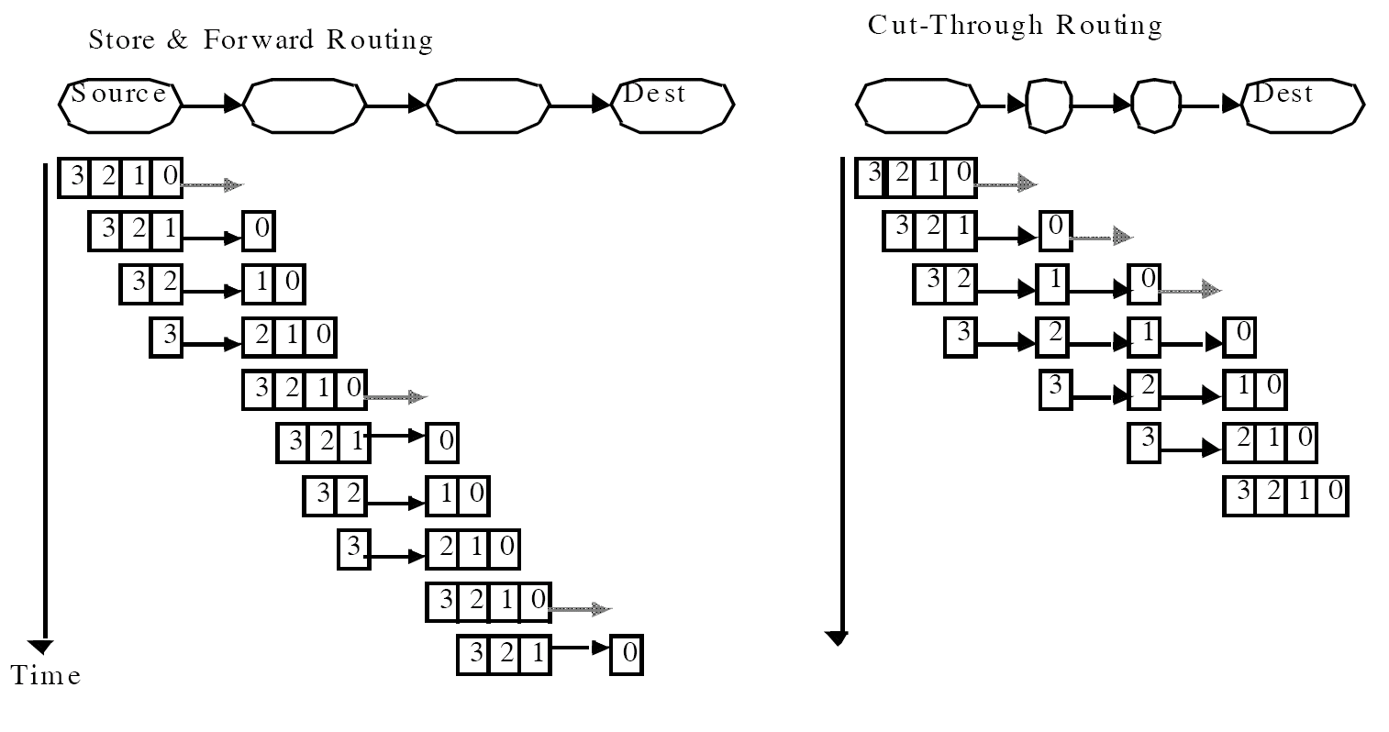
Packet switching versus cut-through switching
Time = H (p/b + L) Time = n/b + H L (fix: p/b + H L)
When L is small, the time is independent of the hop count.
Latency scalability

Slide 7
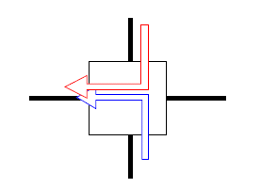
Cut-through routing variations
Cut through routing: when the header of a message is blocked, the whole message will continue until it is buffered in the blocked router.
Need to be able to buffer multiple packets
High buffer requirement in routers
Eventually, the buffer will be filled up.
Wormhole routing
Cut through routing with buffer for only one flit for each channel
Minimum buffer requirement
Each channel has the flow control mechanism - when the buffer is used, signal sender to not send anything until the buffer is cleared.
When the header is blocked, the message stop moving (the message may be buffered in a distributed manner, occupying buffers in multiple routers).

Slide 8
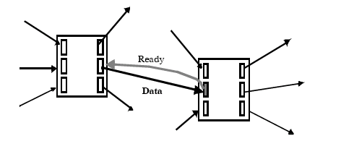
Contention and link level flow control
Two messages try to use the same outgoing link
One needs to either buffer one message, drop one message, or misroute one message.
Wormhole networks try to block in place: link-level flow control.
A message may occupy multiple links.
Cut through routing has the same effect when more data are in the network.
This kind of networks are also call lossless networks (as compared to lossy network)
No packet is ever dropped by the network.
Is the Internet lossless? Which one is better, lossy or lossless network?

Slide 9
Wormhole Flow control
d
s

Slide 10
Head-of-line blocking
If the header flit cannot move due to contention, other worms may not be able to proceed even when the link (channel) is idle.
Red cannot proceed due
to head of line blocking
Link idle
Buffer full, blue blocked by orange

Slide 11
Virtual channel
If each link has only one “head”, head-of-line blocking will be a big problem.
Maintaining multiple buffers (virtual channels) for each link alleviates the head of line blocking problem.
Virtual channel basically virtualizes the link and can be used to solve other problems such as deadlock.
William Dally, “Virtual Channel Flow Control”, TPDS, 1992.

Slide 12
Lossless network and tree saturation
Lossless networks have very different congestion behavior from lossy networks such as the Internet
In a lossy networks, congestion is limited to a small region.
In a lossless network with cut-through or wormhole routing, congestion will spread to the whole network.
Messages that do not use the congested link may also be blocked.
This is known as tree saturation.
The congested link is the root of the tree.

Slide 13
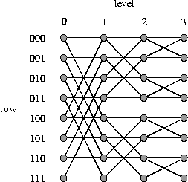
Tree saturation example
001->000
111->000
blocked

Slide 14
Tree saturation
001->000
111->000
011->001
110->001
Not directly go
through the
congested link,
but blocked.

Slide 15
Tree saturation
Tree saturation
can happen in any topology

Slide 16
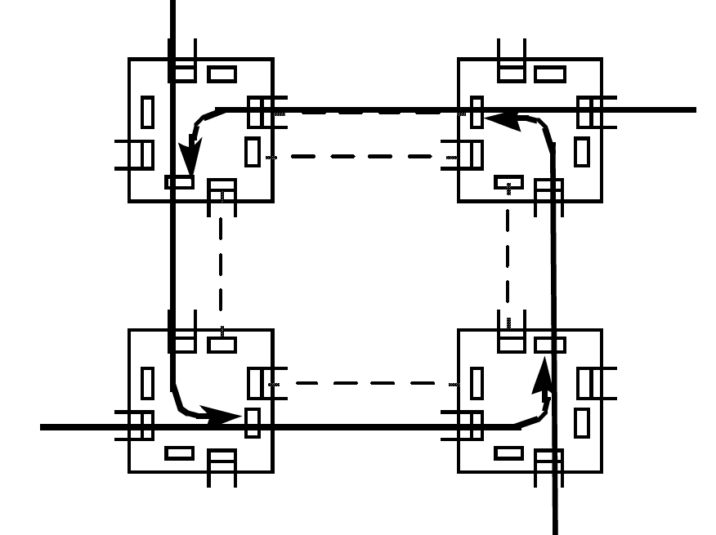
Lossless network and deadlock
Wormhole routing: hold on to the buffer when blocked.
Hold and wait → this is the formula for deadlock.
Solution?

Slide 17
Virtual channels alleviate the deadlock problem
A logical channel can be realized with one buffer and the related flow control mechanism.
At one time, one message use the link.
We can allow multiple messages to share the link by having multiple virtual channels:
Each virtual channel has one buffer with the related flow control mechanism.
The switch can use some scheduling algorithm to select flits in different buffer for forwarding.
With virtual channel, the train slows down, but not stops when there is network contention.

Slide 18
Deadlock avoidance
Layered routing
No loop in each virtual channel
Routing to avoid forming loops
Increase virtual channel ID every time a packet passes a link (works for low dimensional topology).

Slide 19
Routing
Once the topology is fixed, routing determines the path from the source to the destination.
Why routing matters? Consider an 8-node ring with two routing schemes, shortest path routing and random routing.
Evaluating the performance of an interconnect often uses some well known communication patterns.
0
1
2
3
4
5
6
7

Slide 20
Common traffic patterns used in interconnect evaluation
Derived from applications
Important to stress test the network with different patterns
For each topology and pattern, one can derive the average hop count (latency) and maximum link load (throughput).
Random uniform: each packet has a randomly selected source and/or destination.
Random permutation: Each node is a source and a destination in this pattern.
Special permutations:
Bit reversal:
Bit complement:
Tornado:

Slide 21
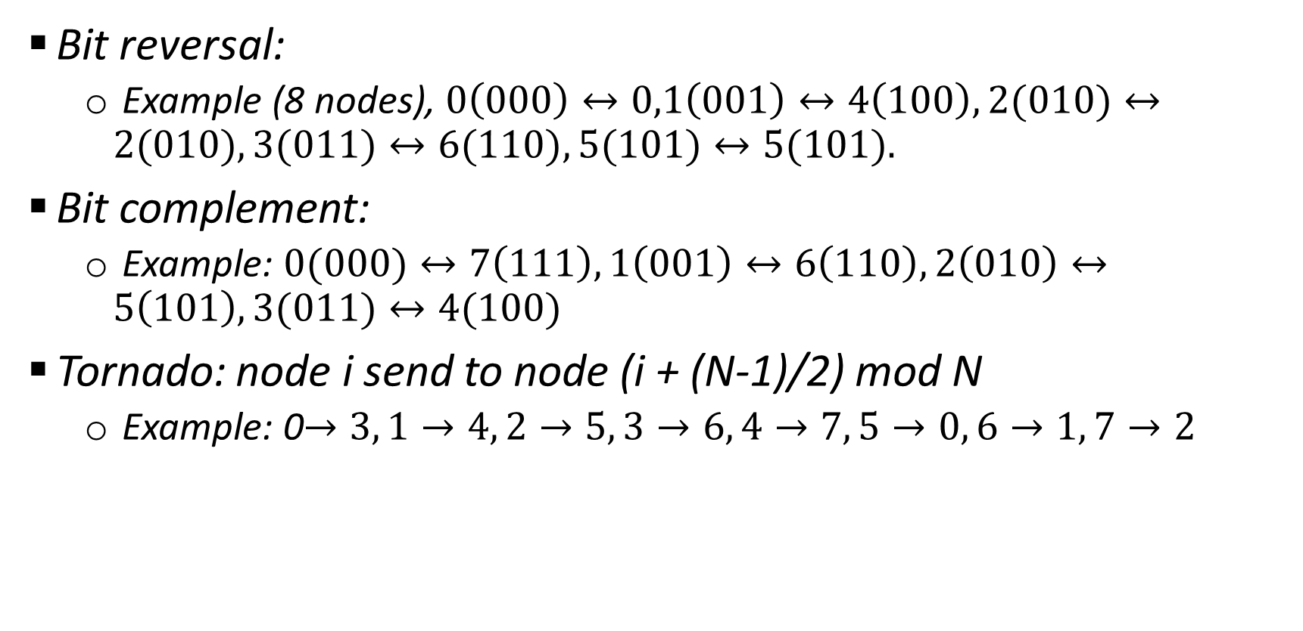
Common traffic patterns
Bit reversal:
Example (8 nodes), $0\left(000\right)↔0,1\left(001\right)↔4\left(100\right), 2(010)↔2(010), 3(011)↔6(110), 5(101)↔5(101).$
Bit complement:
Example: $0(000)↔7\left(111\right), 1\left(001\right)↔6\left(110\right), 2\left(010\right)↔5\left(101\right), 3(011)↔4(100)$
Tornado: node i send to node (i + (N-1)/2) mod N
Example: 0$→3, 1→4, 2→5, 3→6, 4→7, 5→0, 6→1, 7→2$

Slide 22
Analyzing the routing performance with the Tornado pattern in the 8-node ring topology: average hop count
0
1
2
3
4
5
6
7
Shortest path routing: average hop count = 3
Random routing: same direction hop count = 3, the other direction, hop count = 5. Average hop count = (3+5)/2 = 4

Slide 23
Analyzing the routing performance with the Tornado pattern in the 8-node ring topology: maximum link load
0
1
2
3
4
5
6
7
Shortest path routing: maximum link load = 3 (throughput = 1/3)
Channel on the other direction is not used!
Random routing: Each packet will pick the direction randomly. ½ goes clockwise, ½ goes counter-clockwise. Clockwise link load = 3/2, counter-clockwise link load = 5/2. Throughput = (1/(5/2))=0.4

Slide 24
Routing classification: how to select path
How to select among the set of all possible paths from a source to a destination
Deterministic: Always choose the same route
Example: shortest path routing in ring
Restrictive, but can be easily implemented
Oblivious: Choose the route without considering the current network state information
Example: random routing on ring
Deterministic is a special oblivious routing
Adaptive: Choose the route based on the network state
based on congestion metrics: link buffer occupancy, history of link load

Slide 25
Routing classification: path length
Minimal routing: always use shortest path
Example: shortest path routing on ring
Non-minimal routing: may use non-shortest path
Example: random routing on ring

Slide 26
Routing classification: routing mechanism
Source routing: message include a list of intermediate nodes (or ports) toward the destination. Intermediate routers just lookup and forward. A source routed packet format is as follows:
Destination based routing: message only includes the destination address. Intermediate routers use the address to compute the output port (e.g. dest addr as an index to the forwarding table).
What is the routing used in the Internet?

Slide 27
Dimension order routing in a mesh/torus
X Y Routing: Always go X first then Y
Minimal and deterministic, deadlock free (no loop)
Not take advantage of the path diversity in the topology, poor load balancing
DC
DA
DB
SA
SB
SC

Slide 28
Dimension order routing in a mesh/torus
What about randomly goes XY or YX
Minimal and deterministic
Better load balancing. Need additional mechanism to resolve deadlock
DC
DA
DB
SA
SB
SC

Slide 29
Valiant’s routing algorithm
How: Randomly select an intermediate node I, route packet from s to I and then from I to d.
Randomizes any traffic pattern
All patterns become like random uniform
Balance network load
Non-minimal routing, high latency.
No communication locality any more
I
d
s

Slide 30
Valiant’s routing for Tornado pattern on the 8-node ring
0
1
2
3
4
5
6
7
1/8 traffic
1/16 traffic
Both phases are random uniform. Let us look at each phase.
For random uniform, all links will have the same load in the ring. Let us look at the link from 3 to 4.
Traffic in 3->7 can go either clockwise or counter-clockwise, so count half in one direction.
Load for one phase = 6/8 + 4/16 = 1. Total load = 2 and throughput = 0.5.

Slide 31
Adaptive routing
Can be minimal or non-minimal
Uses network state to make routing decisions
Buffer occupancies are often used
Local information readily available
Global information more costly to obtain
With flow control, backpressure can imply global congestion (with delay)
Network state changes rapidly.
Using local information leads to sub-optimal results.

Slide 32
Local information may result in sub-optimal choice
d
Low load link
Median load link
High load link
s

Slide 33
Non-minimal adaptive routing
Potentially use more
resources. Low
performance under high
load
d
Low load link
Median load link
High load link
s

Slide 34
Mechanism to sense remote congestion: backpressure
0
1
2
3
4
5
6
7
3->7 have two potential equal length paths
Initially 3->7 chooses the clockwise path. 5-> 6 is already ongoing. Link 3->4 does not sense congestion at the beginning. Since 5->6 cannot handle the load, packet buffer builds up at node 5. When it is full, it will not accept packets, and eventually buffer in node 4 will be full. Then buffer at node 3 will be full and 3 can sense the congestion. This is called backpressure.
Backpressure allows local queue length to reflect remote congestion.

Slide 35
Deadlock free routing
Make sure that the loop can never occur
Put constraints on how paths can be used to route traffic.
Use infinite virtual channels.
Deadlock free routing example:
Up/down routing
Select a root node and build a spanning tree
Links are classified as up links or down links
Up links: from lower level to upper level
Down links: from upper level to lower level
Link between nodes in the same level: up/down based on node number
Path: all up link, all down link, a sequence of up links followed by a sequence of down links
No up link can follow a down link.
Why deadlock free?
Can we have disconnected nodes?

Slide 36
Deadlock free routing
Is X-Y routing on mesh deadlock free?
How about adaptive routing on mesh that always use the shortest paths?

