Slide 1
Scalable Multiprocessors
Large scale computing systems
Scalability issues
Low level and high level communication abstractions in scalable systems
Network interface
Common techniques for high performance communication

Slide 2
Scalable computers
Today’s data centers are very large. What kinds of systems can scale to a large size?
Almost all computers allow the capability of the systems to be increased
Add memory, add disk, upgrade processor, etc.
A scalable system attempt to avoid inherent design limits on the extent to which resources can be added to the system.
Total communication bandwidth increases with P.
Latency (time per operation) remains a constant (not increase with P).
Cost increases slowly (at most linearly) with P.
How to package the (large/scalable) systems. Or, can we build a large systems with the design?

Slide 3
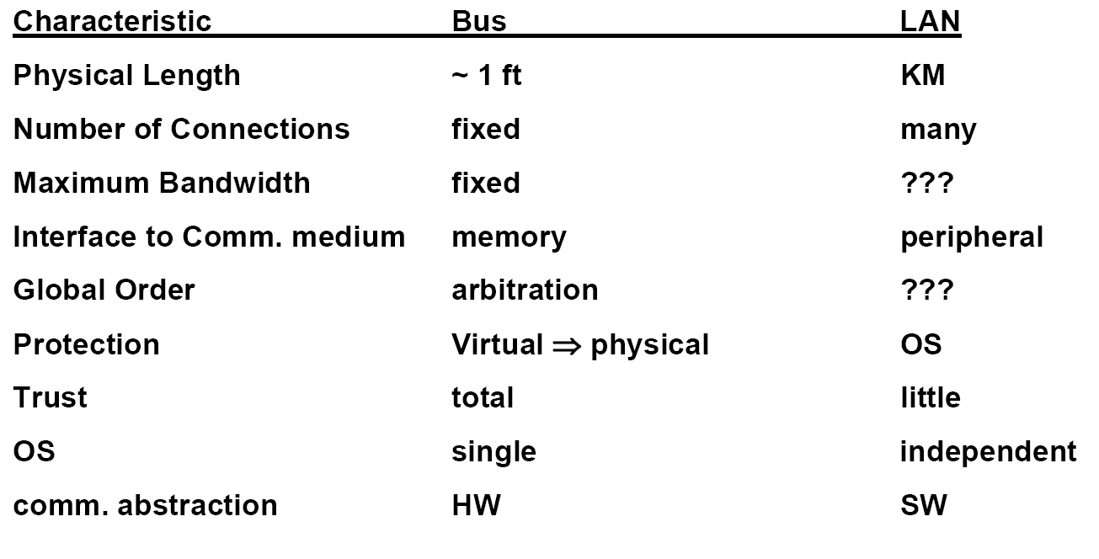
Example: Bus based SMP and Local Area Networks (LAN)
Are they scalable?
Bus: Close coupling among components, but has a scaling limit.
Ethernet: no limit to physical scaling, little trust, no global order, independent failure and restart. Bandwidth does not scale.

Slide 4
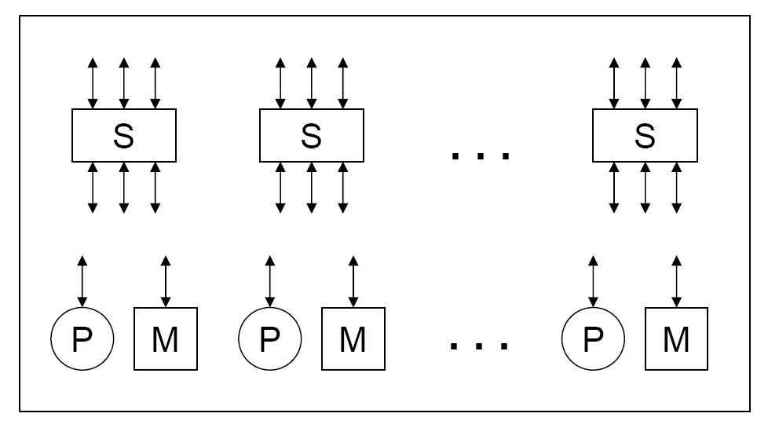
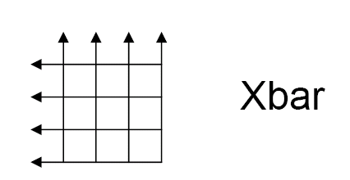
Bandwidth scalability
What fundamentally limits bandwidth?
The set of wires
Processors and memory modules must have independent wires.
Modules must be connected through “switches” (or scalable interconnects) that allows wires connected to the ports to be independent.

Slide 5
Latency scalability
Latency = overhead + channel time + routing delay.
Overhead: software/hardware processing time before the message is sent.
Channel time: message size / channel bandwidth* # of channels.
# of channels usually increases as P increases.
Routing delay: is usually a function of H (number of hops between two nodes) and P.
H usually increases as P increases.
To make latency scalable: channel time and routing delay needs to be a constant.

Slide 6
Cost Scaling
cost(p, m) = fixed cost + incremental cost (p, m)
Scalable machines must support many configurations.
Both fixed cost and incremental cost are important:
Without volume, fixed cost can be very high.

Slide 7
Communication in scalable computers
Components are far apart in a large scale computing system.
The system must support communication among the components in a cost-effective manner.
The communication subsystem (from software communication library to the hardware interconnection network) is a key component in a scalable computer.
Layers of abstractions

Slide 8
Communication abstractions
High level and low level communication abstractions in scalable systems are often separated.
Layered design principle.
Low level:
Provide accesses to communication hardware.
Perform primitive network transactions.
High level:
Provide functionality for communications in different programming models.
Shared memory space abstraction
Message passing abstraction

Slide 9
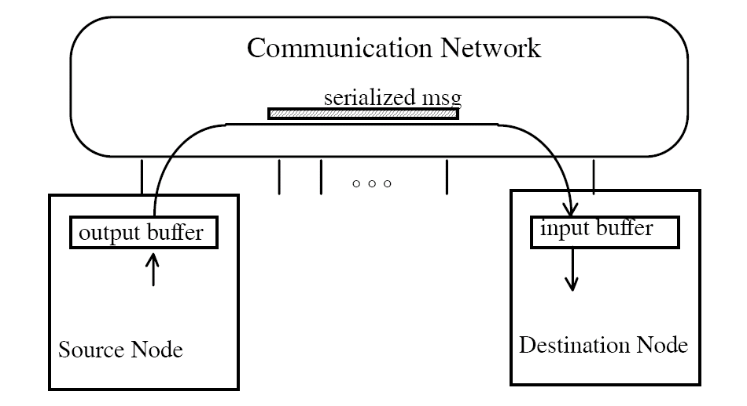
Network Transaction Primitive (low level)
One-way transfer of information from a source output buffer to a destination input buffer.
causes some action at the destination
occurrence is not directly visible at source
Deposit data, state change, reply

Slide 10
Shared address space abstraction
No storage logically “outside” the application address space.
Read and write remote memory (as well local memory, but this does not involve communication)
Operations are fundamentally request/reply: read request/read reply with data; write request with data/write acknowledgement
Source and destination data addresses are specified by the source of the request.
A degree of logical coupling and trust.
Remote operation can be performed on remote memory
This may or may not require intervention of the remote processor.

Slide 11
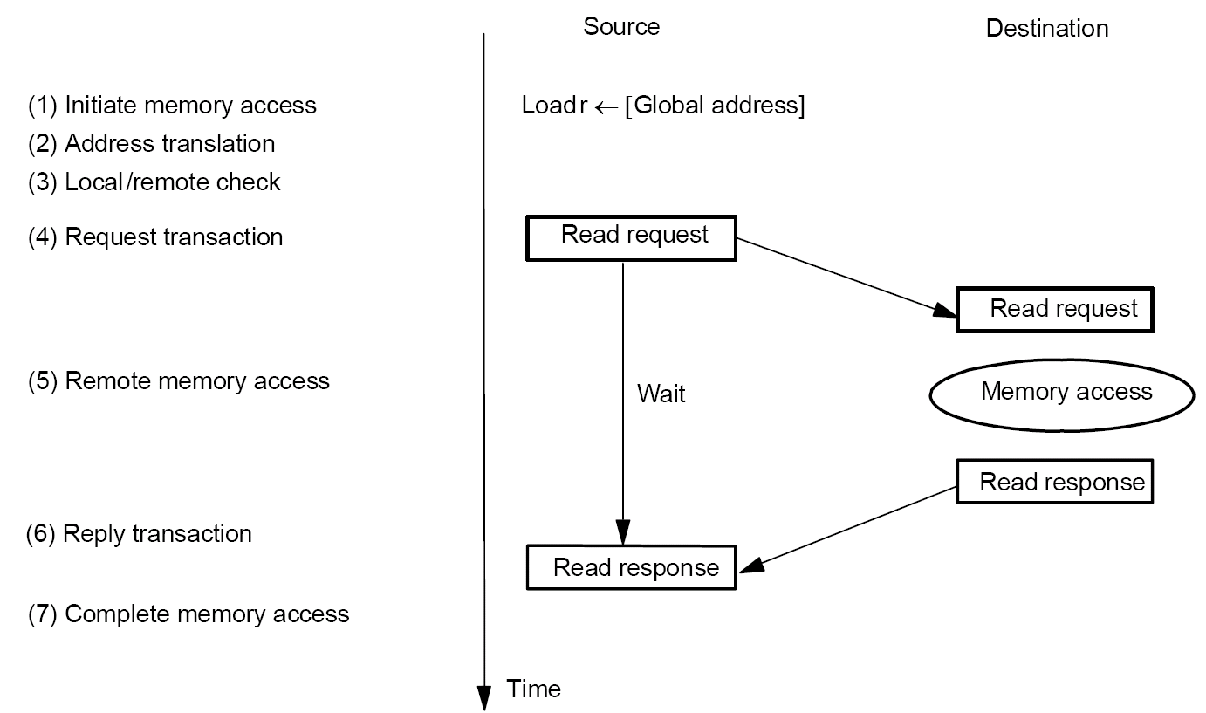
Shared Address Space Abstraction (high level)
The following figure shows the read operation.
Fundamentally a two way request/response protocol.
Write has an acknowledge.

Slide 12
Issues in Shared Address Space Abstraction
Fixed or variable length (bulk) transfers.
Remote virtual or physical address?
Deadlock avoidance (circular dependence when input buffers are full)

Slide 13
Message passing abstraction
For a programming paradigm where coordination and communication between processes are through explicit message passing (instead of shared memory), message passing abstraction is needed.
Sender only knows about its memory and receiver only knows about its own memory.
Need a handshake for both of them to have all information about the communication.
Synchronous message passing
Send completes after matching recv and source data sent
Recv completes after data transfer complete from matching send
Asynchronous message passing
Send completes after send buffer may be reused.

Slide 14
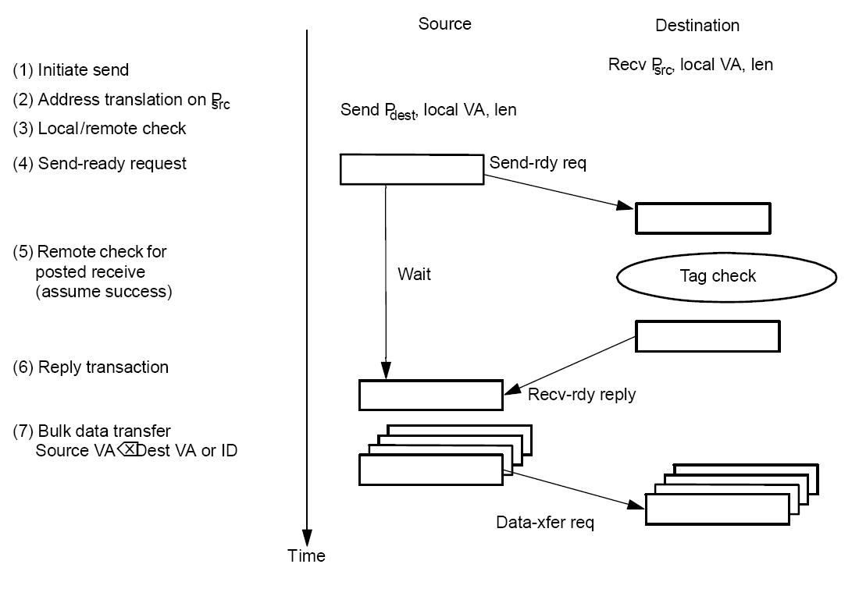
Synchronous Message Passing

Slide 15
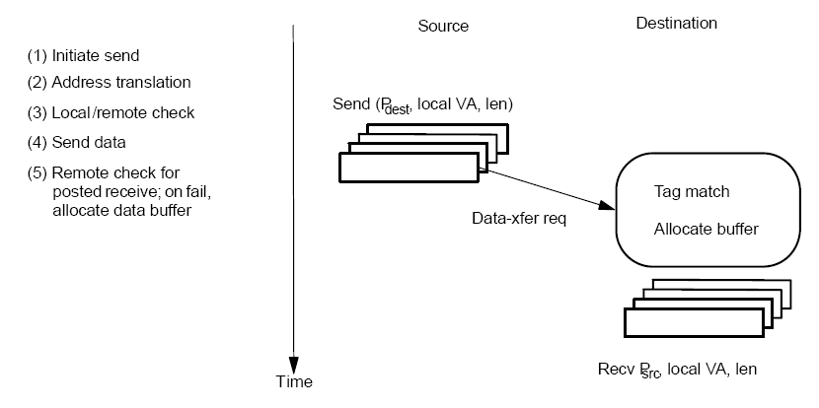
Asynchronous Message Passing: Optimistic
Wildcard receive ➔ non-deterministic
Storage requirement within messaging layer.

Slide 16
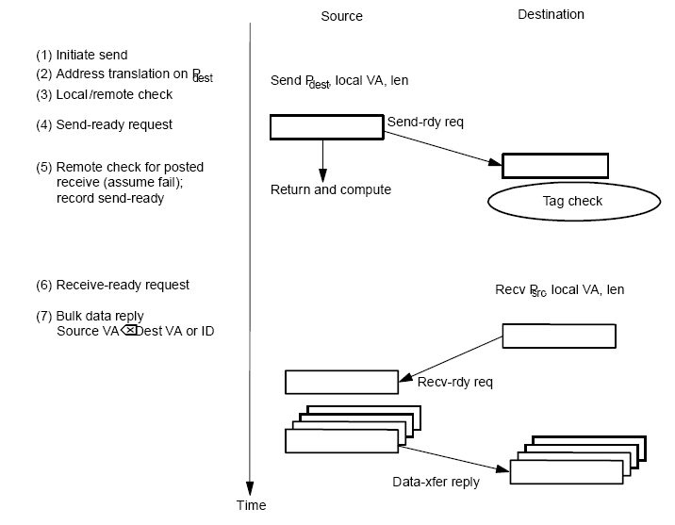
Asynchronous Message Passing: Conservative
Where is the buffer?
Contention control? Receiver initiated protocol
Short message optimizations

Slide 17
Summary of message passing abstraction
Arbitrary storage outside the local address space
May post many sends before any receives
Non-blocking asynchronous sends reduces the requirement to an arbitrary number of descriptors
There are limits to these too.
Fundamentally a 3-phase transaction
Includes a request/response
Can use optimistic 1-phase in limited safe cases

Slide 18
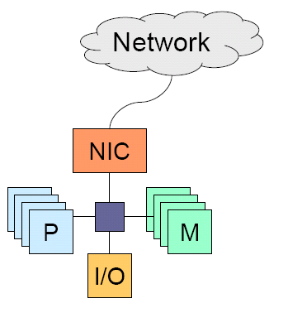
Network interface
Network interface (card) is used to access the network
Transfer between local memory and NIC buffers. Basic operations
SW translates VA⬅➔ PA
SW initiate DMA
SW does buffer management
NIC initiates interrupts on receive
Provides protection
Transfer between NIC buffers and the network
Generate packets
Flow control with the network

Slide 19
Typical sender/receiver operations in a system with a low end NIC
Sender:
Trap into operating systems
Translate (logical) destination address into physical address or the route to the destination
Copy data into OS and construct the whole packet
Select the outgoing channel, set the status registers (starting address, count, etc), and start the communication.
Depending on NIC hardware, starting comm may take many instructions
Receiver:
An interrupt is generated
The processor reads the received data into a OS region.
CPU is still involved with a low end NIC. With a high-end NIC, the CPU operations can be offloaded to the communication processor in the NIC.

Slide 20
Protected User-level Communication
Traditional NIC (e.g. Ethernet) requires the OS kernel to initiate DMA and to manage buffers.
Protection
High overhead: kernel/user space switching in communication critical path.
Newer NICs (InfiniBand, Myrinet)
OS initializes the network ports to provide protection.
Applications access the ports from the user domain.
Kernel/user space switching is no longer needed in send/recv.

Slide 21
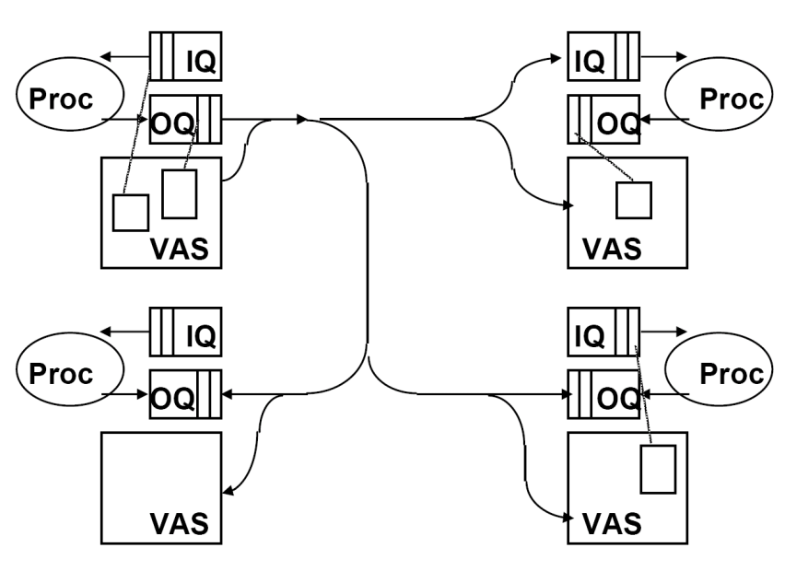
User-level communication
Any user process can post a transaction for any other in protection domain
Communication layer moves the source OQ to the desitnation IQ
May involve indirection: the source virtual memory to destination virtual memory (RDMA).

Slide 22
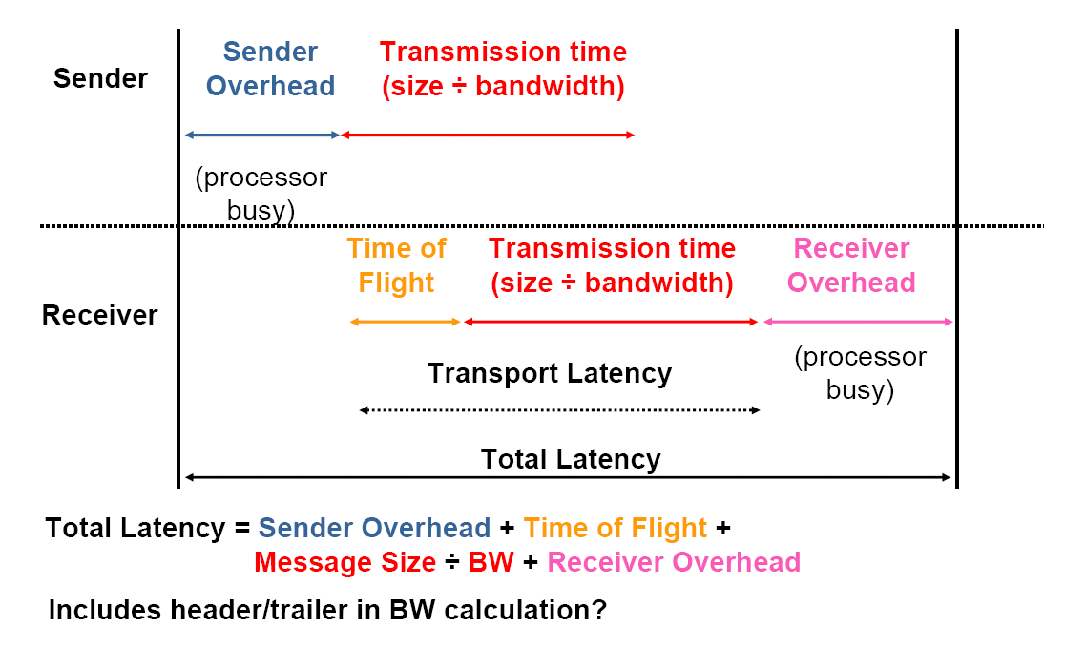
Network performance metrics

