Slide 1
Shared Memory Architectures
Introduce different shared memory architectures
Introduce the cache coherence problem and cache coherence protocol.

Slide 2
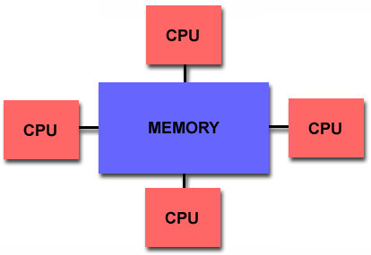
Shared memory architectures
Multiple CPU’s (or cores)
One memory with a global address space
  May have many modules (to increase memory bandwidth)
  All CPUs access all memory through the global address space
All CPUs can make changes to the shared memory
  Changes made by one processor are visible to all other processors.
Data parallelism or function parallelism? MIMD

Slide 3
Major issue: How to connect CPU and memory
Ideal effect:
  Large memory bandwidth
  Low memory latency
When accessing remote objects, bandwidth and latency are always key metrics. Think of the user experience when downloading small files versus a very large file.

Slide 4
Shared memory architectures: UMA and NUMA
One large memory
  One the same side of the interconnect
    Mostly Bus
  Memory references from different CPUs have the same distance (latency)
  Uniform memory access (UMA)
Many small memories
  Local and remote memory
  Memory references from different CPUs have different distance to memory location (latency is different)
  Non-uniform memory access (NUMA)

Slide 5
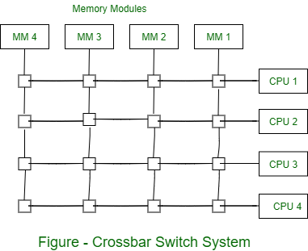
Bus-based UMA Shared memory architecture
Many processors and memory modules connect to the bus
  This architecture dominated in the server domain in the past.
Faster processors began to saturate the bus as the bus technology cannot keep up with CPU processing power
Bus interconnect may also be replaced by an crossbar interconnect, but that is expensive.

Slide 6
NUMA Shared memory architecture
Identical processors, processors have different time for accessing different part of the memory.
Memory resides in “NUMA domains.”
The current generation SMPs adopt the NUMA architecture. AMD EPYC multi-chip module (MCM) processor is shown in the left. Memory is distributed to each module.

Slide 7
Various SMP hardware organizations

Slide 8
Cache Coherence Problem
Due to the cache copies of the memory, different processors may see the different values of the same memory location.
Processors see different values for u after event 3.
With a write-back cache, memory may store the stale date.

Slide 9
Bus Snoopy Cache Coherence protocols
Memory: centralized with uniform access time and bus interconnect.

Slide 10
Bus Snooping idea
Send all requests for data to all processors (through the bus)
Processors snoop to see if they have a copy and respond accordingly.
  Cache listens to both CPU and BUS.
  The state of a cache line may change by (1) CPU memory operation, and (2) bus transaction (remote CPU’s memory operation).
Requires broadcast since caching information is at processors.
  Bus is a natural broadcast medium.
  Bus (centralized medium) also serializes requests.

Slide 11
Types of snoopy bus protocols
Write invalidate protocols
  Write to shared data: an invalidate is sent to the bus (all caches snoop and invalidate copies).
Write broadcast protocols (typically write through)
  Write to shared data: broadcast on bus, processors snoop and update any copies.

Slide 12
An Example Snoopy Protocol (MSI)
Invalidation protocol, write-back cache
Each block of memory is in one state
  Clean in all caches and up-to-date in memory (shared)
  Dirty in exactly one cache (exclusive)
  Not in any cache
Each cache block is in one state:
  Shared: block can be read
  Exclusive: cache has only copy, its writable and dirty
  Invalid: block contains no data.
Read misses: cause all caches to snoop bus (bus transaction)
Write to a shared block is treated as misses (needs bus transaction).

Slide 13
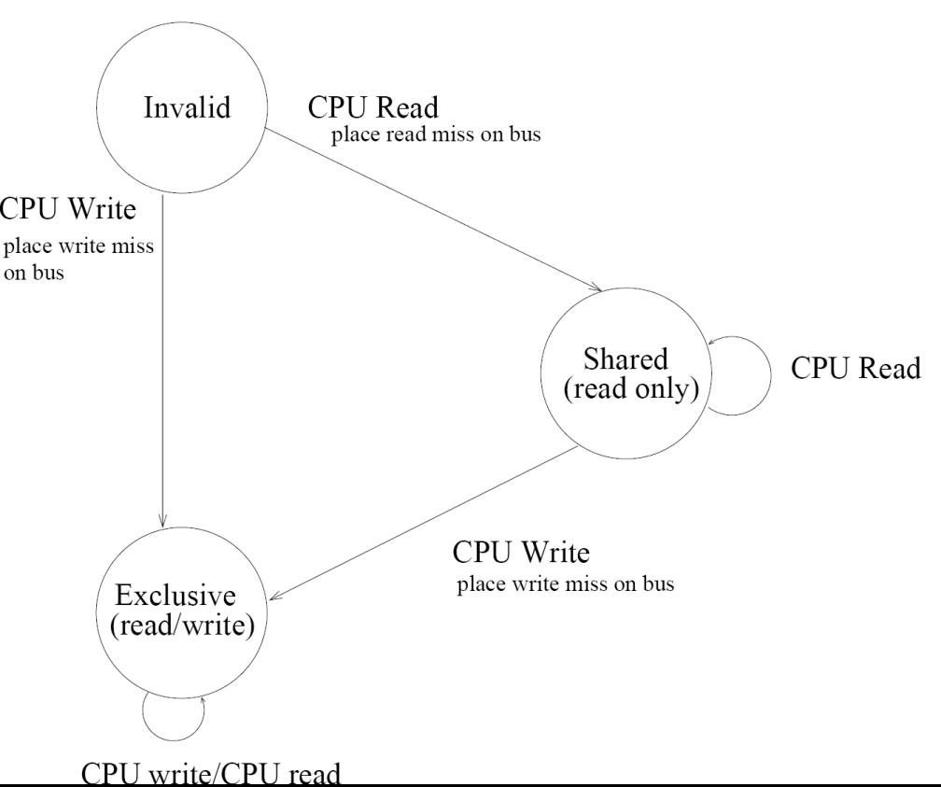
MSI protocol state machine for CPU requests

Slide 14
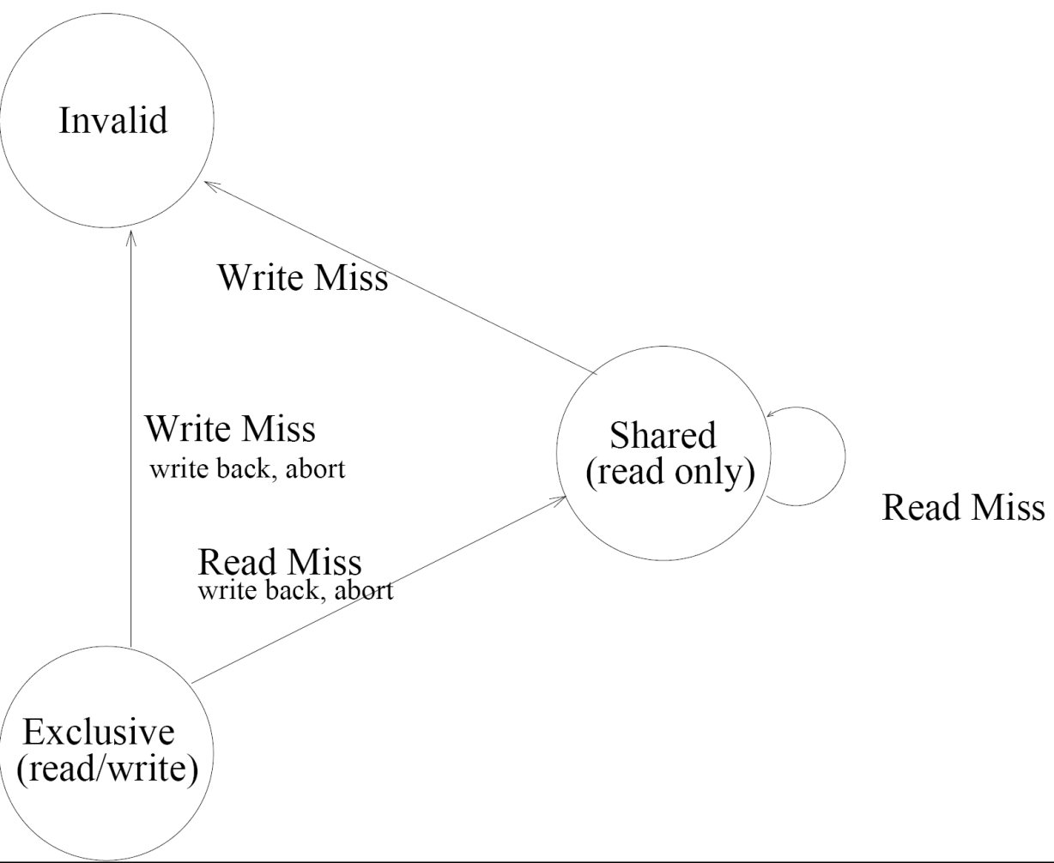
MSI protocol state machine for CPU requests

Slide 15
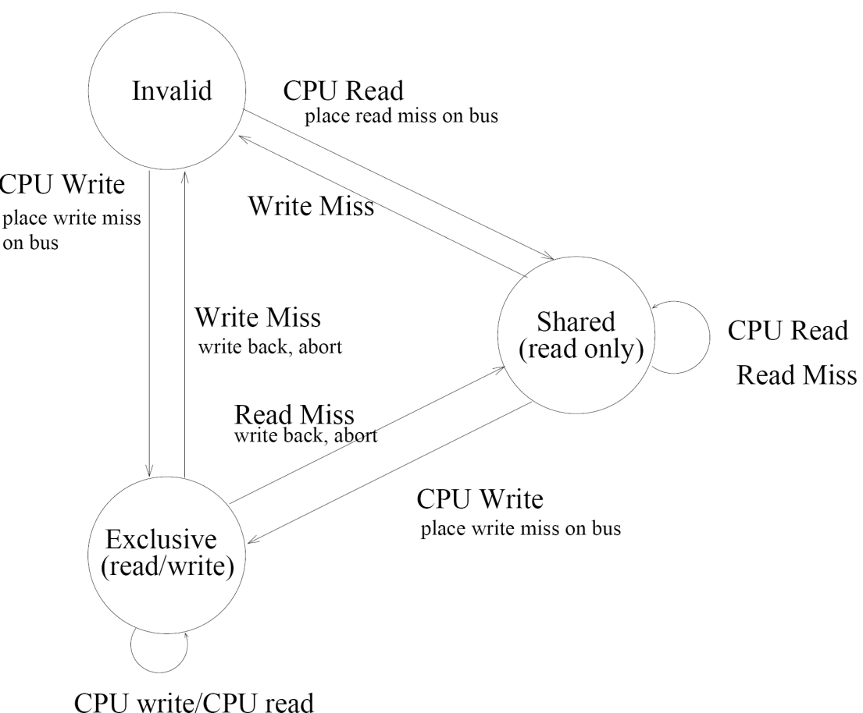
MSI protocol state machine for CPU requests

Slide 16
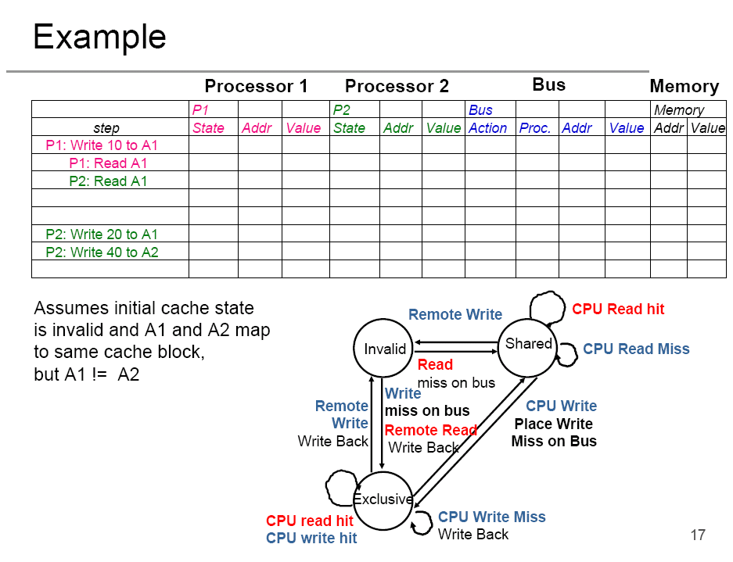

Slide 17
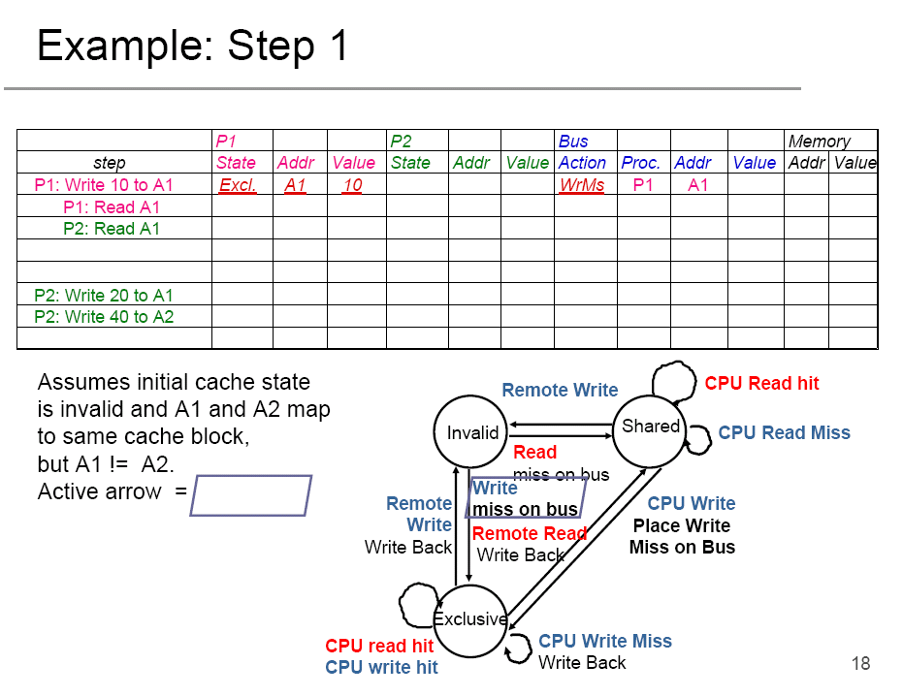

Slide 18
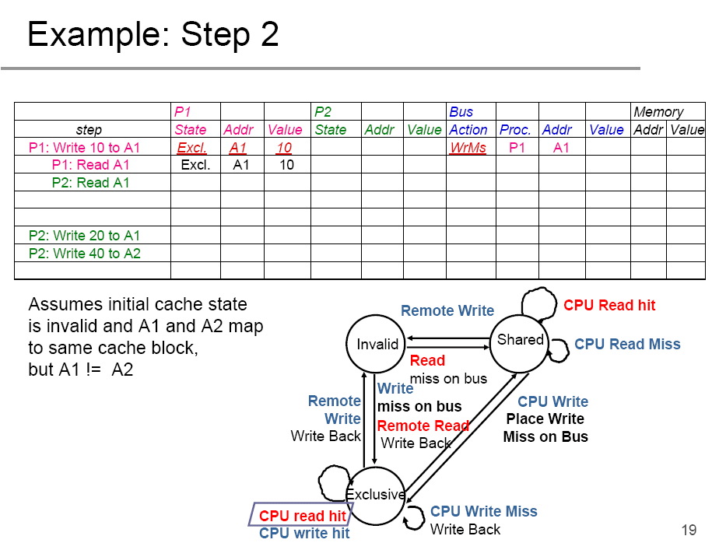


Slide 19
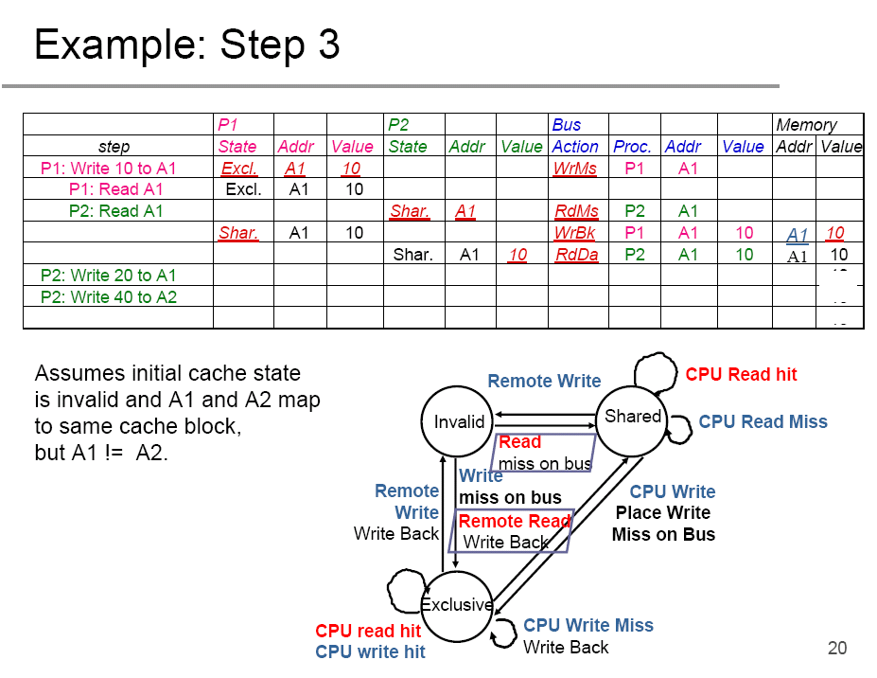

Slide 20
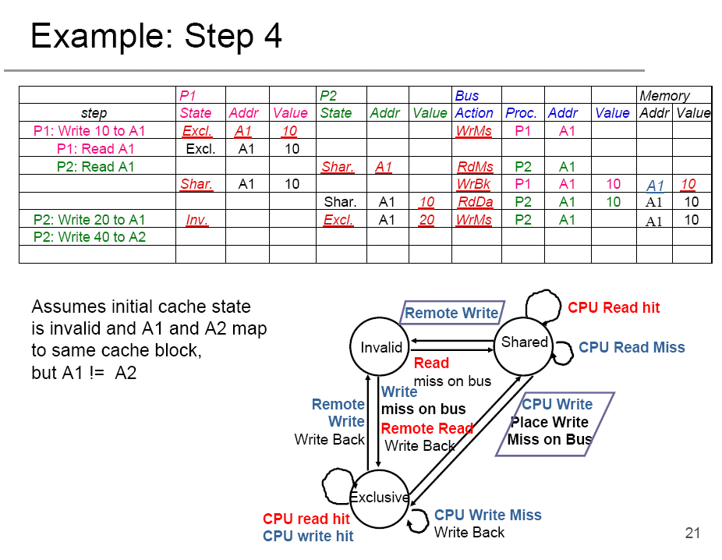

Slide 21
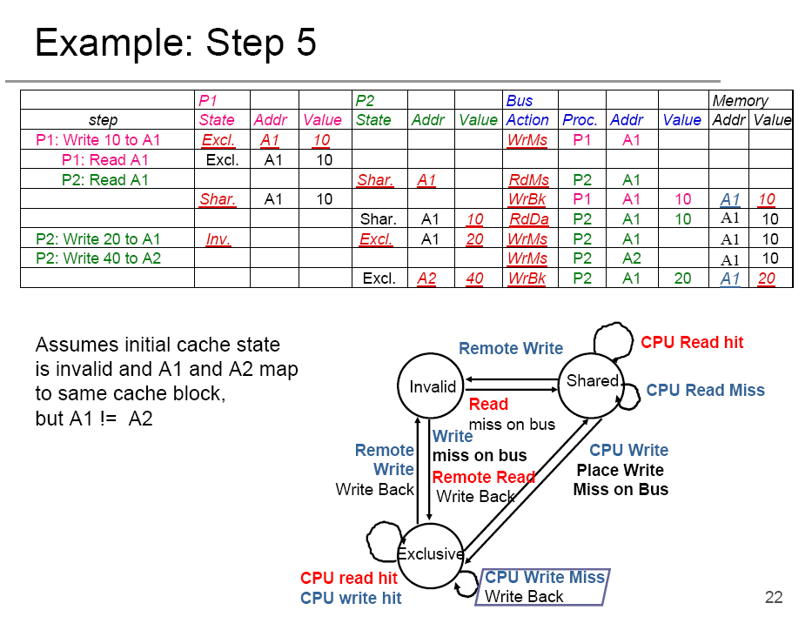

Slide 22
MSI cache coherence protocol variations
Basic MSI Protocol
  Three states: MSI.
  Can optimize by refining the states so as to reduce the bus transactions in some cases.
Berkeley protocol
  Five states, M → owned, exclusive, owned shared.
MESI protocol (four states)
  M → modified and Exclusive.
MESIF – protocol used in Intel processors
  MESI + S →S and F (Cache should be the responder for a request)
MOESI – protocol used in AMD processors

Slide 23
Multiple levels of caches
Most processors today have on-chip L1 and L2 caches.
Transactions on L1 cache are not visible to bus (needs separate snooper for coherence, which would be expensive).
Typical solution:
  Maintain inclusion property on L1 and L2 cache so that all bus transactions that are relevant to L1 are also relevant to L2: sufficient to only use the L2 controller to snoop the bus.
  Propagating transactions for coherence in the hierarchy.

Slide 24
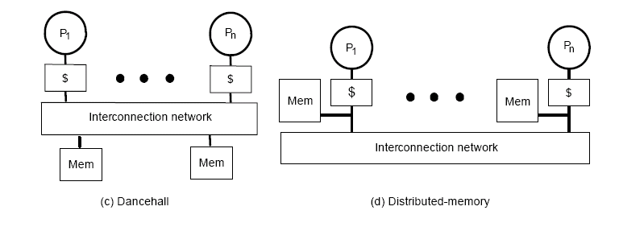
Large share memory multiprocessors
The interconnection network is usually not a bus.
No broadcast medium → cannot snoop.
Needs a different kind of cache coherence protocol.

Slide 25
Cache coherence for large SMPs
Similar idea as MSI protocol, but the interconnect does not have broadcast.
  Use a directory to record where (who the owner is) of each memory line.
Use a directory for each cache line to track the state of every block in the cache.
  Can also track the state for all memory blocks → directory size = O(memory size).
Need to used distributed directory
  Centralized directory becomes the bottleneck.
    Who is the central authority for a given cache line?
Typically called cc-NUMA multiprocessors

Slide 26
Performance implication of shared memory architecture
NUMA architecture can have very large impact on performance
Cache coherence protocol can also have impacts
  Memory write is even more expensive
  False sharing issue
    One thread’s cache behavior can affect other thread’s performance

Slide 27
Summary
Share memory architectures
  UMA and NUMA
  Bus based systems and interconnect based systems
Cache coherence problem
Cache coherence protocols
  Snoopy bus
  Directory based

